Slide 1
Does cross-linguistic similarity play a role in reading? A self-paced reading study with Polish-English-Norwegian multilinguals
Anna Skałba, Sylwiusz Żychliński

Slide 2
Presentation outline
Aims
Constructions under investigation / hypotheses
Study design:
Participants
Stimuli
Procedure
Preliminary results (descriptive stats, statistical analyses)
Discussion points (feedback welcome!)

Slide 3
Aims
Testing the influence of cross-linguistic similarity (L1=L2=L3 vs. L1=L3 / L2=L3) on sentence comprehension in L3 using the self-paced reading task

Slide 4
Constructions
Lexical-syntactic (present in three languages)
prepositional verbs and adjectives
reflexive verbs
Syntactic (present in two languages)
gender agreement (neuter noun + adj)
articles

Slide 5
Prepositional verbs and adjectives
1. NO = EN ≠ PL (same preposition in NO & EN, different in PL)
NO: Disse rommene er nok for / *på
konferanser og møter.
EN: These rooms are enough for / *on conferences and meetings.
PL: Te pomieszczenia są wystarczające *dla / na konferencje i spotkania.

Slide 6
Prepositional verbs and adjectives
2. NO = EN = PL (same preposition in all languages)
NO: Direktøren deres betalte for / om blyanter og papir.
EN: Their director paid for / about pencils and paper.
PL: Ich dyrektor zapłacił za / o ołówki i papier.

Slide 7
Prepositional verbs and adjectives
Hypothesis: RTs shorter for NO = EN = PL than for NO = EN ≠ PL, both for correct and incorrect sentences
negative influence/interference from L1 Polish when Polish is different
L1 facilitation for NO = EN = PL: comparison of PL-EN-NO with EN-NO groups

Slide 8
Reflexive verbs
1. NO = PL ≠ EN (reflexive in NO & PL, non- reflexive in EN)
NO: Søsteren hans føler seg / *Ø ofte dårlig.
EN: His sister ofte feels *herself / Ø bad.
PL: Jego siostra często czuje się / *Ø źle.

Slide 9
Reflexive verbs
2. NO = PL = EN (reflexive in all three languages)
NO: Den unge gutten skadet seg / *Ø kraftig i fingeren.
EN: The little boy hurt himself / *Ø badly in the finger.
PL: Mały chłopiec mocno skaleczył się / *Ø w palec.

Slide 10
Reflexive verbs
Hypothesis: RTs shorter for NO = EN = PL than for NO = PL ≠ EN, both for correct and incorrect sentences
negative influence/interference from L2 English when English is different
L2 facilitation for NO = EN = PL: comparison of PL-EN-NO with EN-NO groups

Slide 11
Gender agreement
NO = PL (neuter in NO & PL)
NO: Dette dyret er sultent / *sulten om vinteren.
PL: To zwierzę jest głodne / *głodny w zimie.
2. NO ≠ PL (neuter in NO but masculine or feminine in PL)
NO: Dette kjøleskapet er tomt / *tom hele tiden.
PL: Ta lodówka jest cały czas *puste / pusta.

Slide 12
Gender agreement
Hypothesis: RTs shorter for NO = PL than for NO ≠ PL, both for correct and incorrect sentences
positive influence from L1 Polish when NO = PL

Slide 13
Articles
NO = EN (indefinite articles)
NO: Denne filmen er en / *Ø tegnefilm om to prinsesser.
EN: This film is a / *Ø cartoon about two princesses.
2. NO ≠ EN (definite articles)
NO: Denne parken er skogen / *skog hun jogget i.
EN: This park is the / *Ø forest in which she was jogging.

Slide 14
Articles
Hypothesis: RTs shorter for NO = EN than for NO ≠ EN, both for correct and incorrect sentences
positive influence from L2 English when NO = EN

Slide 15
Participants
34 Polish-English-Norwegian multilinguals (Szczecin: 23, Poznań: 11)
L1 Norwegian speakers (control group data collection in progress)
English proficiency – Cambridge General English placement test (max. 25 points; M = 19.65/25; SD = 3.00)
Norwegian proficiency – UiT placement test (max. 36 points; M = 27.85; SD = 5.64)

Slide 16
Stimuli
Key words: no cognates between Norwegian, English and Polish; frequency 3-6 on Zipf scale (NoWaC corpus, https://tekstlab.uio.no/glossa2/nowac_1_1)
Key word position: 4th - 2nd word from the end of the sentence
Length of sentences: 6-8 words
192 sentences: 12 sentences per condition x 2 grammatical variations (grammatical vs. ungrammatical) x 4 grammatical constructions

Slide 17
Procedure
1. Non-cumulative self-paced reading task in
Norwegian
Sentences appearing word by word
Pressing the space bar to see the next word (one word is replaced by another one)
Each sentence followed by a binary choice grammaticality judgement question
2. Binary-choice grammaticality judgement task in English

Slide 18
Preliminary results: mean RTs
construction | grammaticality | condition: similar | condition: different | outcome
prepositions | grammatical | 638.2576 | 801.4520 | 🙂
 | ungrammatical | 671.5354 | 824.7803 | 🙂
reflexives | grammatical | 647.4672 | 733.2247 | 🙂
 | ungrammatical | 731.8207 | 759.0404 | 🙂
gender | grammatical | 966.7121 | 928.851 | 🙁
 | ungrammatical | 1037.5732 | 1021.333 | 🙁
articles | grammatical | 856.6187 | 1056.0884 | 🙂
 | ungrammatical | 931.2955 | 958.6086 | 🙂

Slide 19
Preliminary results
Except for gender, in all constructions: shorter RTs for conditions similar between NO and PL and/or EN than for conditions differing across languages
Definite articles: longer RTs for correct than for incorrect sentences (in NO the definite article is a suffix)

Slide 20
Statistical analyses
linear mixed-effects model
RT ~ condition * grammaticality + (1+condition * grammaticality|participant) + (1+condition * grammaticality|sentence)

Slide 21
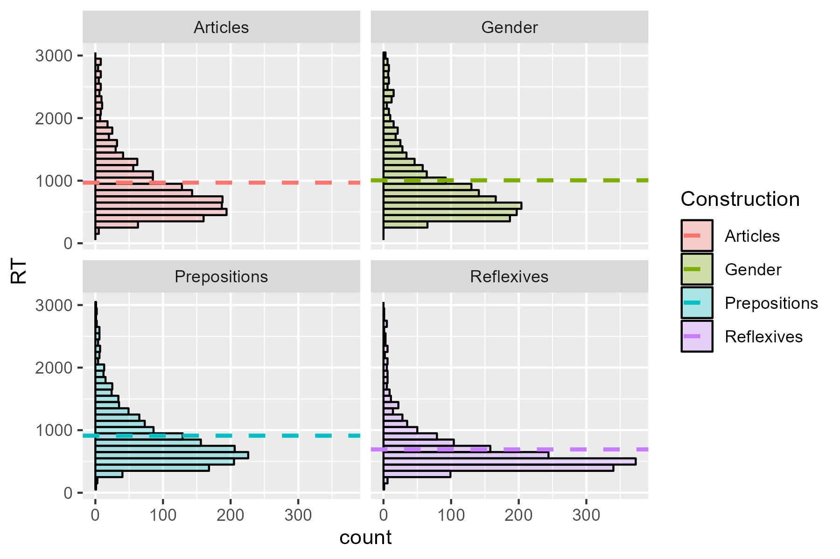

Slide 22
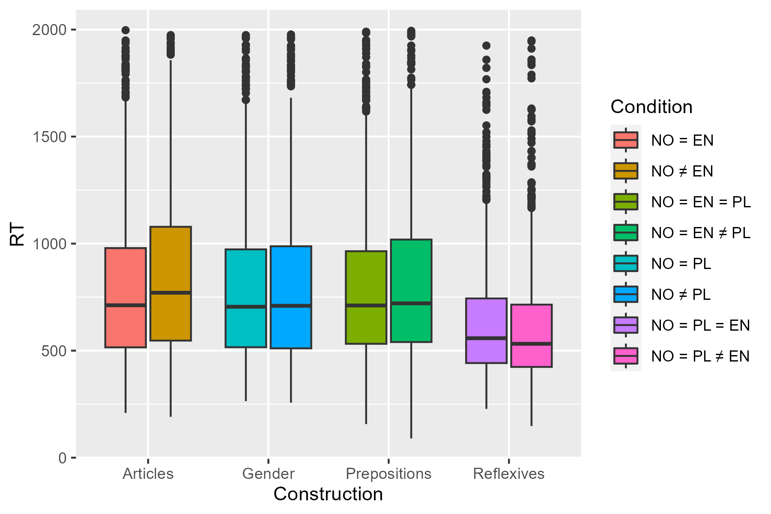

Slide 23
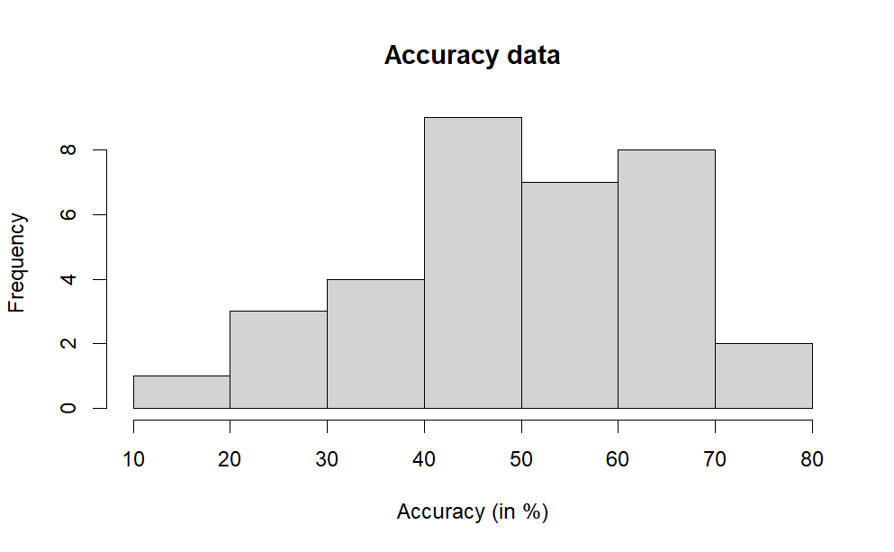

Slide 24
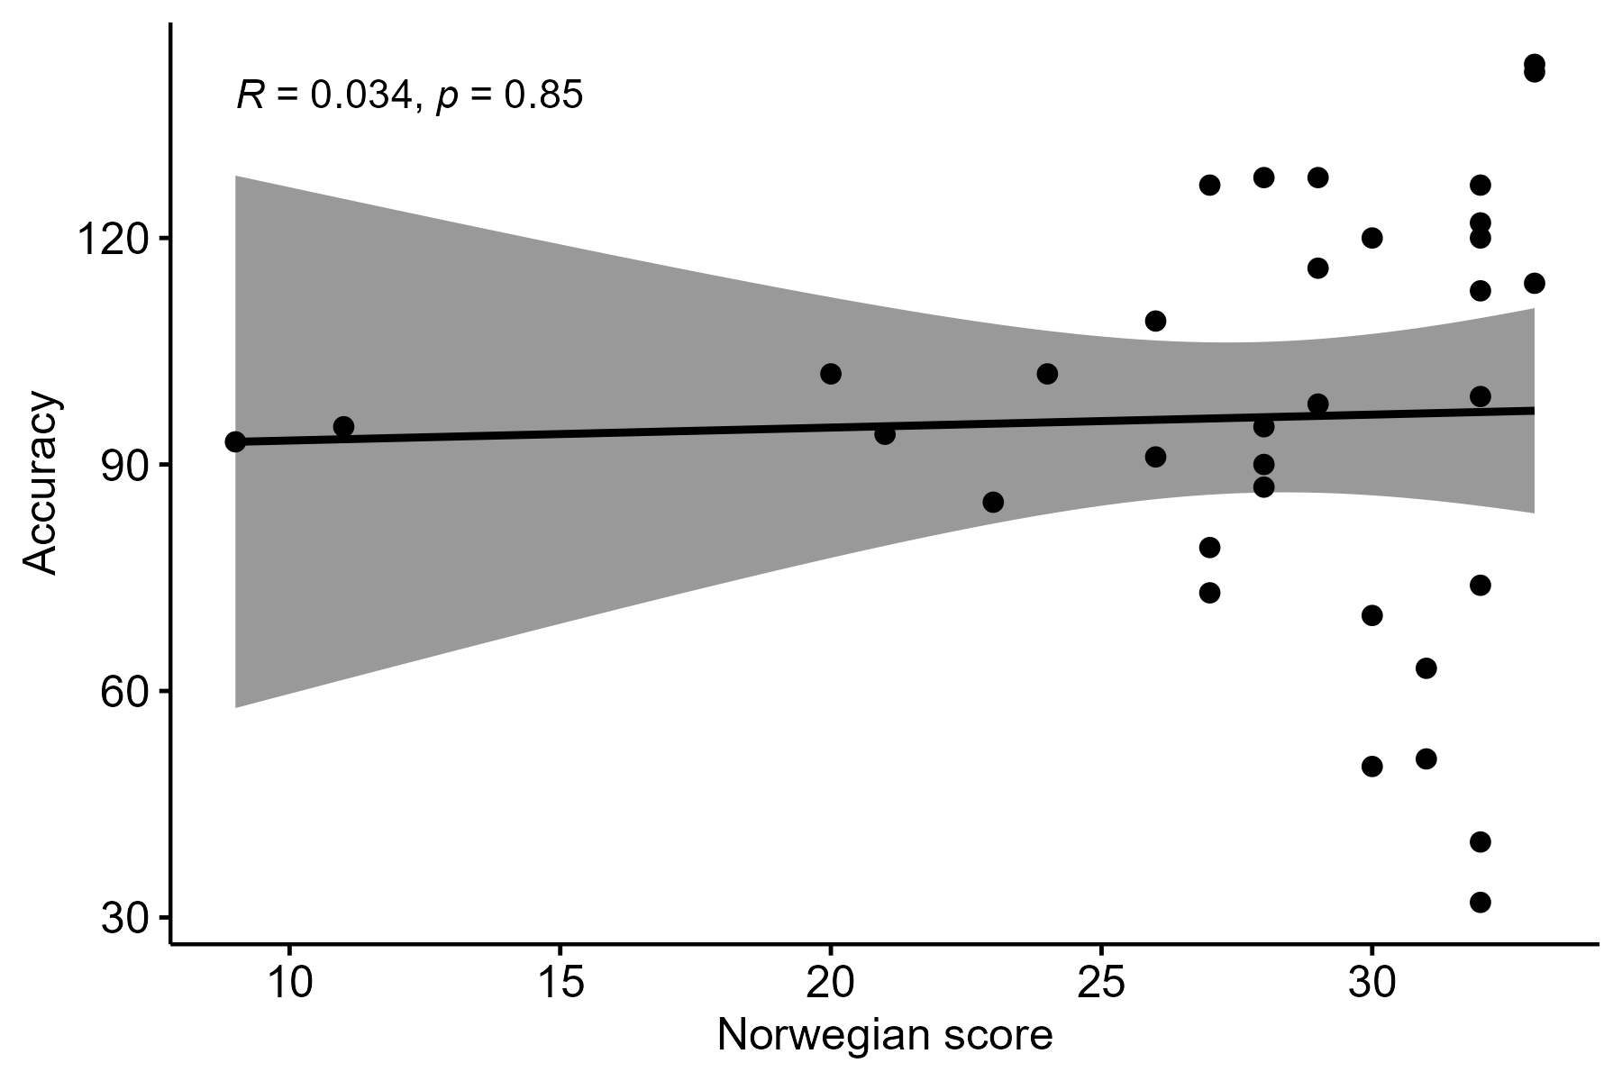
Correlation between Norwegian proficiency and accuracy

Slide 25
Discussion points: data for analysis
Data inclusion criteria?
All data, irrespective of accuracy
Cut-off point for discarding participants and items
Only data points with correct accuracy

Slide 26
Thank you!

