Slide 1
The neurophysiology of phonemic perception in multilingual speakers
Hanna Kędzierska, Karolina Rataj, Anna Balas, Zuzanna Cal, Chloe Castle, Magdalena Wrembel
06.06.2023

Slide 2
Phonemic perception in L2/Ln
Jakoby et al., 2011; Liang & Chen, 2022; Song & Iverson, 2018
vital component of successful L2/Ln learning
reduced phonemic discrimination mechanisms in the L2
L3/Ln
unknown language

Slide 3
Oddball paradigm
Oddball:
a sequence of frequently occurring standard stimuli interrupted by the occasional appearance of deviant stimuli)
MMN:
a negative-going wave deflection of frontocentral distribution with a peak at around 150-250 milliseconds from change onset.
P300 and LDN:
often following the MMN. P300 is associated with switch of attention, LDN involves additional cortical resources to extract the difference.
µV
Fz
LDN
-4
MMN
-2
0
2
4
-200
0
200
400
600
ms

Slide 4
Previous studies
MMN
A similar MMN response to Finnish vowel contrast in native speakers of Finnish and a group Hungarian late learners of Finnish (a naturalistic setting) (Winkler et al., 1999).
A significant difference between native speakers of English and advanced Finnish students of English (a classroom setting) (Peltola et al., 2003).
MMN was attenuated in poor L2 perceivers (the importance of individual speech-specific capabilities) (Díaz et al., 2016).
Different neural responses in adult Mandarin learners of English with high and low proficiency levels (Liang and Chen, 2022).

Slide 5
Research questions
Questions
Will any significant distinctions emerge in L3/Ln as opposed to L1 and L2?
Predictions
We predict the MMN effect to be stronger in native when compared with non-native speech (Jakoby et al., 2011; Liang & Chen, 2022; Näätänen et al., 1997; Song & Iverson, 2018)
The scale of the MMN effect in L2 when compared with L3/Ln is, however, impossible to predict due to the lack of previous studies which would focus on such a comparison
Will phonological contrasts be equally easy to detect and process in native and non-native languages?
Will there be any statistically significant differences between formal and naturalistic language learners?

Slide 6
Participants
AMU
23 participants:
formal language learners,
mean age = 22.55 (range: 18–38),
five males,
college students (N = 18),
AoA (English) = 5.86 years (range: 3–10),
AoA (Norwegian) = 20.27 years (range: 13–36),
Norwegian as chronologically the third (N = 9), the fourth (N = 11), the fifth (N = 1) or the sixth (N = 1) language
college graduates (MA, N = 4),

Slide 7
Experimental stimuli
Sounds
Polish: /ɨ/-/ɛ/ English: /ɪ/-/ʊ/ Norwegian: /i/-/ʏ/
We used possibly similar standard sounds in Polish, English and Norwegian.
The deviant sound were selected to be language-specific with approximately comparable distance from the standard one.
Vowel | F1 | F2 | F3 | ED
/ɨ/ | 468 | 1948 | 2821 | 231
/ɛ/ | 675 | 1916 | 2722
/ɪ/ | 394 | 1828 | 2882 | 483
/ʊ/ | 390 | 1345 | 2896
/i/ | 357 | 1917 | 2587 | 161
/ʏ/ | 313 | 2015 | 2708

Slide 8
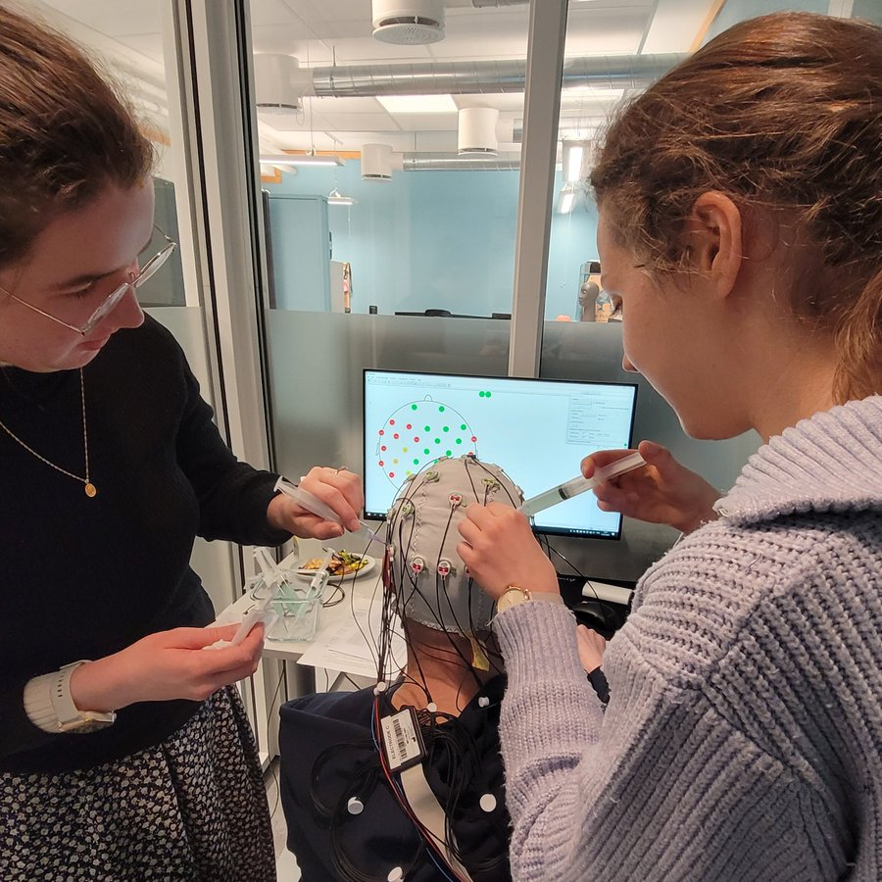
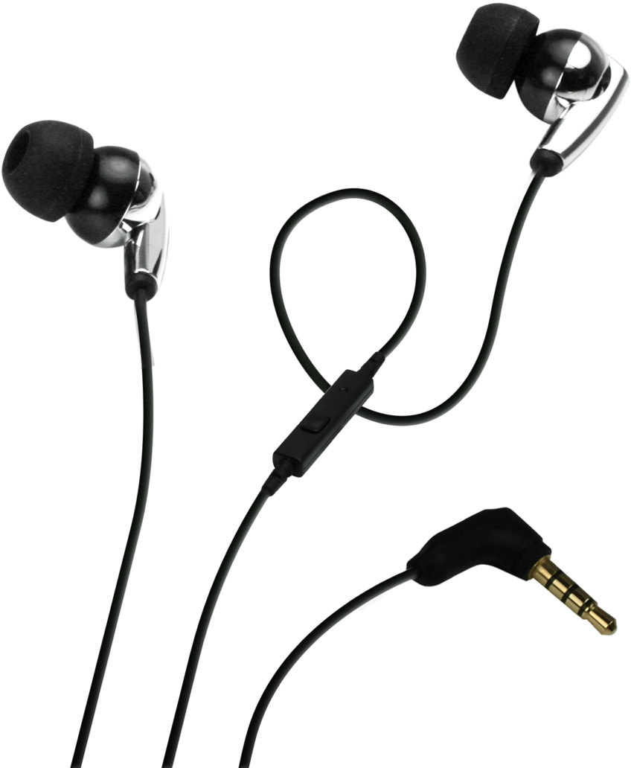
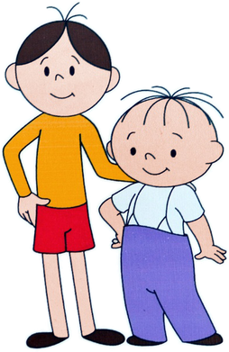
Procedure
Preparation
Experiment
Tests
consent, surveys
cap preparation (64 active electrodes)
sound stimuli presentation
cartoon watching
language tests
gating task
BAG BEG

Slide 9
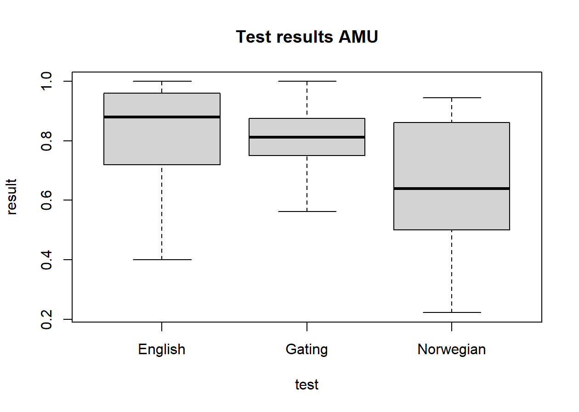
Behavioral tests results
Proficiency tests and gating task results
OTHER RESULTS:
English skills self-assessed as 5.85 (range: 5.25–7, SD = 0.60)
Norwegian skills self-assessed as 3.88 (range: 2–6.5, SD = 1.16)
movie comprehension test average of 73.64% correct responses (range: 50%–100%, SD = 16.20%)
mean laterality quotient (LQ) equal to 85.91% (range: 45.00%–100,00%, SD = 16.74%)
M = 82.00% (SD = 16.22%)
M = 79.83% (SD = 12.34%)
M = 65.78% (SD = 22.41%)

Slide 10
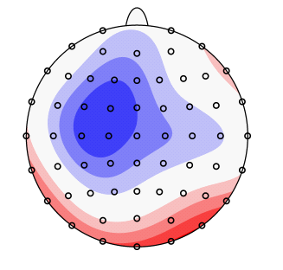
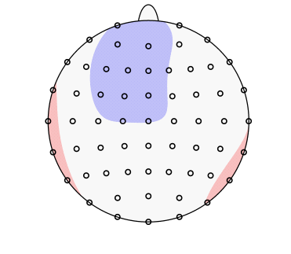
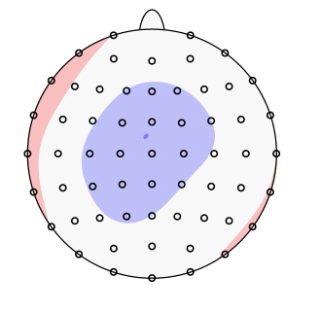
MMN 100-180 ms
a linear mixed effects analysis of the relationship between the processed language, the status of the processed sound as standard or deviant and hemisphere (left or right)
MMN (LH)
MMN (LH)
MMN
***
***
L1 POLISH
L2 ENGLISH
L3/Ln NORWEGIAN
no significant difference

Slide 11
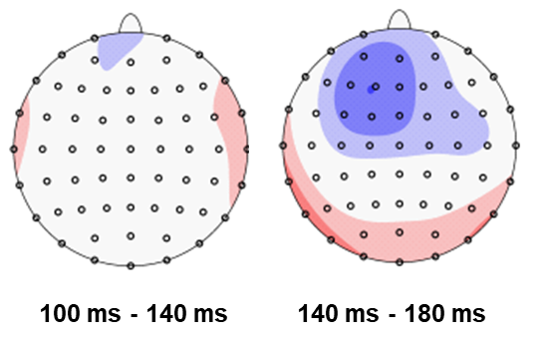
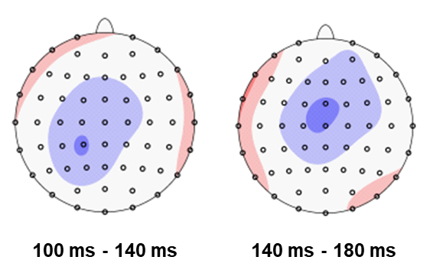
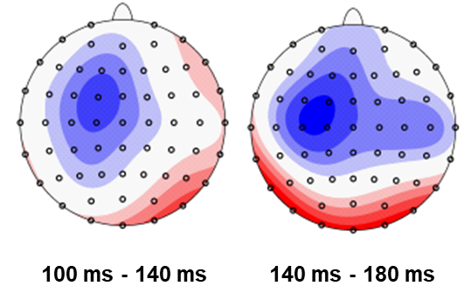
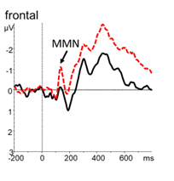
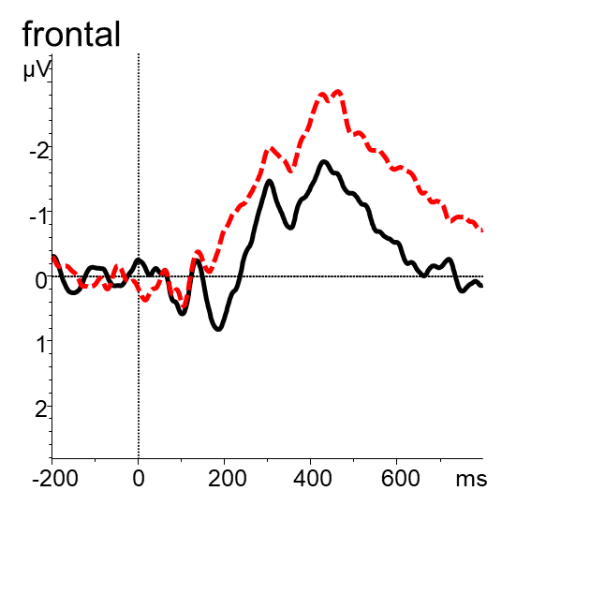
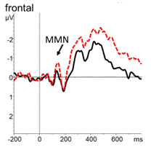
ERP results: MMN
MMN (LH)
MMN
LDN
MMN (LH)
MMN
L1 POLISH
L2 ENGLISH
L3/Ln NORWEGIAN

Slide 12
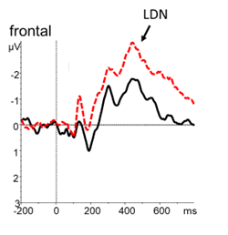
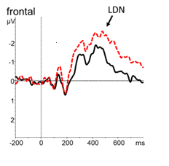
ERP results: LDN
LDN
LDN
LDN
LDN
LDN
LDN
LDN
L1 POLISH
L2 ENGLISH
L3/Ln NORWEGIAN

Slide 13
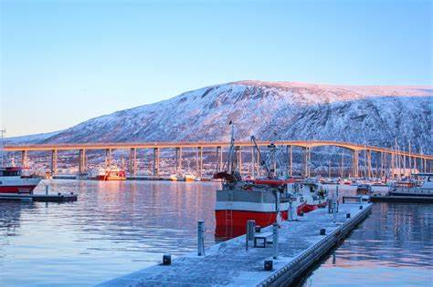
A follow-up study (UiT)
UiT
17 participants (Jan-Feb 2023):
naturalistic learners of Norwegian,
still ongoing,
AoA (English) = 9.76 years (range: 5–29),
AoA (Norwegian) = 27.59 years (range: 7–43)
various professions,

Slide 14
ERP results: UiT (ongoing)
µV
µV
µV
Fz
Fz
Fz
-4
MMN
-4
MMN
-4
0
0
0
4
4
4
-200
0
200
400
600
ms
-200
0
200
400
600
ms
-200
0
200
400
600
ms
POLISH
ENGLISH
NORWEGIAN

Slide 15
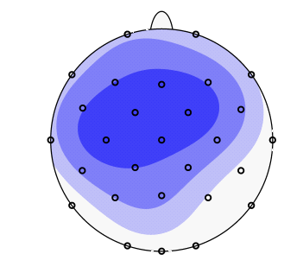
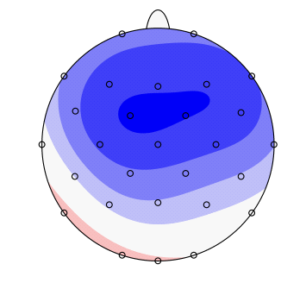
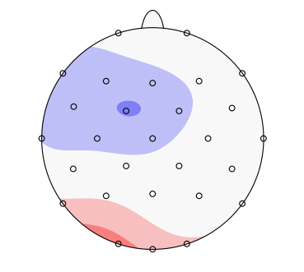
ERP results: UiT (ongoing)
MMN
MMN
POLISH
ENGLISH
NORWEGIAN

Slide 16
Discussion
Predictions testing
Will phonological contrasts be equally easy to detect and process in native and non-native langauges?
The MMN response was deficient for non-native languages (L2 English, L3/Ln Norwegian) when compared to L1 Polish. This is in accordance with our hypothesis and with previous reserach (Jakoby et al., 2011; Liang & Chen, 2022; Näätänen et al., 1997; Song & Iverson, 2018).
Will any significant distinctions emerge in L3/Ln as opposed to L1 and L2?
We have observed differences between L2 English and L3/Ln Norwegian (in terms of MMN).

Slide 17
Discussion
Main findings and open questions
In the early 100-140 ms time window the MMN emerged in L3/Ln Norwegian but not in L2 English.
This finding opens the discussion on the participants’ language dominance as a factor influencing phonemic perception mechanisms.
The level of proficiency and speech specific capabilities might also influence the effect (Diaz et al., 2016; Liang & Chen, 2022). Important: no P300 component observed!
In our study, the only significant correlation observed was that between the MMN magnitude in Norwegian and L3/Ln proficiency level, r(21) = 0.65, p = .02.
The LDN was less pronounced in L3/Ln Norwegian when compared with L1 Polish (but not with L2 English).
This finding opens the discussion on the significance of LDN.
While typically associated with pre-attentive cognitive evaluation of the stimulus (Jakoby et al., 2011), the component is also associated with extracting the phonological difference between STANDARD and DEVIANT (Escera et al., 2000).

Slide 18
Conclusion
First of all, we have replicated previous findings concerning the impaired phonemic perception in non-native languages in formal language learners.
More crucially, the findings clearly suggest that foreign language status as L2 or L3/Ln modulates auditory language processing.
At the same time, the results suggest the relevance of the listeners’ language proficiency and dominance as factors influencing phonemic perception mechanisms.

Slide 19
Open questions
AMU study: Early onset of the LDN in English.
The contrast between English and Norwegian only visible in the earlier time window.
Time windows selection (especially for the MMN). Specifically, should we split the 100-180 ms time window into two: 100-140 and 140-180?
AMU study: The fact the LDN was significantly lower in Norwegian than in English.
What are the implications of this finding?
Is the component pre-attentive? (see Jakoby et al., 2011 for a discussion)
How strongly is the component’s strength associated with Standard/Deviant difference ratio?

Slide 20
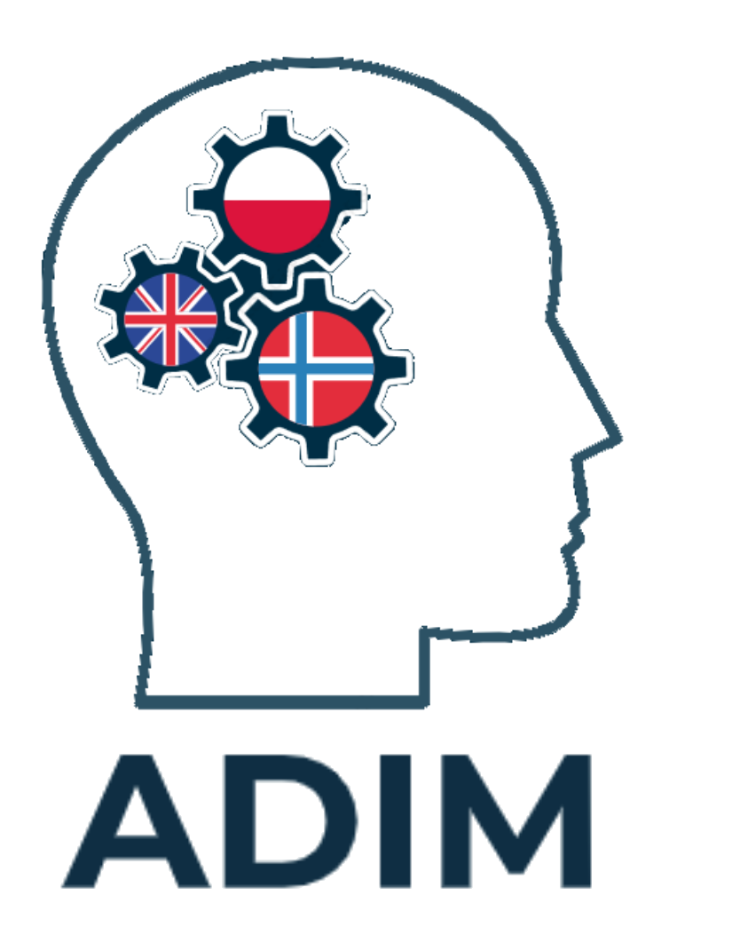
Acknowledgements
This research has been supported financially by the Polish National Science Centre (NCN) in Poland.
ID nr: DEC-2019/34/H/HS2/00495
Period: Dec 2021-April 2024
PIs: Magdalena Wrembel, Marit Westergaard
We thank Tristan Czarnecki-Verner, Agnieszka Pludra, Anna Skałba, Patrycja Kakuba and Kamil Malarski for their assistance with the EEG recordings in Poznań,
Jason Rothman for the opportunity to conduct the study in the PoLaR lab,
Vincent DeLuca and Mahdis Jafari for their invaluable help during data recordings in Tromsø,
and Kamil Kaźmierski for his comments on data analysis.

Slide 21
Thank you
hanked@amu.edu.pl

Slide 22
Statistics (extra): MMN (AMU)
100-140 ms
140-180 ms
Language*Sound*Hemisphere
Compared conditions:
language = Norwegian, hem = left
contrast estimate p.value
deviant - standard -0.2249 0.0443
language = Polish, hem = left
contrast estimate p.value
deviant - standard -0.7225 <.0001
Language*Sound*Hemisphere
Compared conditions:
language = English, hem = left hem = right
contrast estimate p.value estimate p.value
deviant - standard -0.672 <.0001 -0.347 0.0022
language = Norwegian, hem = left hem = right
contrast estimate p.value estimate p.value
deviant - standard -0.277 0.0139 -0.387 0.0006
language = Polish, hem = left hem = right
contrast estimate p.value estimate p.value
deviant - standard -0.859 <.0001 -0.392 0.0005
a linear mixed effects analysis of the relationship between the processed language, the status of the processed sound as standard or deviant and hemisphere (left or right)

Slide 23
Statistics (extra): LDN (AMU)
200-350 ms
350-800 ms
Language*Sound
Compared conditions:
language = Norwegian
contrast estimate p.value
deviant - standard -0.653 <.0001
language = Polish
contrast estimate p.value
deviant - standard -0.959 <.0001
language = English
contrast estimate p.value
deviant - standard -0.836 <.0001
Language*Sound
Compared conditions:
language = Norwegian
contrast estimate p.value
deviant - standard -0.918 <.0001
language = Polish
contrast estimate p.value
deviant - standard -1.241 <.0001
language = English
contrast estimate p.value
deviant - standard -1.069 <.0001
***
***

