Slide 1

The neurophysiology of phonemic perception in multilingual speakers
Hanna Kędzierska, Karolina Rataj, Anna Balas, Zuzanna Cal,
Magdalena Wrembel
01.06.2023

Slide 2

Presentation plan
Introduction
Phonemic perception in L1 and L2.
The ERP technique.
Oddball paradigm (MMN/P300/LDN).
Current study
Participants.
Materials.
Procedure.
Results
Discussion

Slide 3

Phonemic perception in L2/Ln
Jakoby et al., 2011; Liang & Chen, 2022; Song & Iverson, 2018
vital component of successful L2/Ln learning
reduced phonemic discrimination mechanisms in the L2
L3/Ln
unknown language

Slide 4
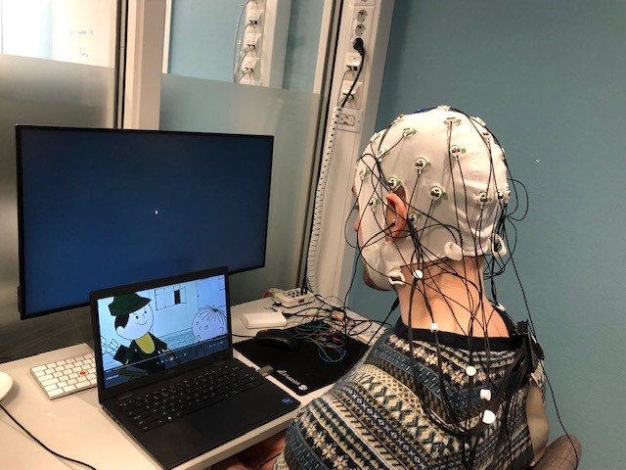
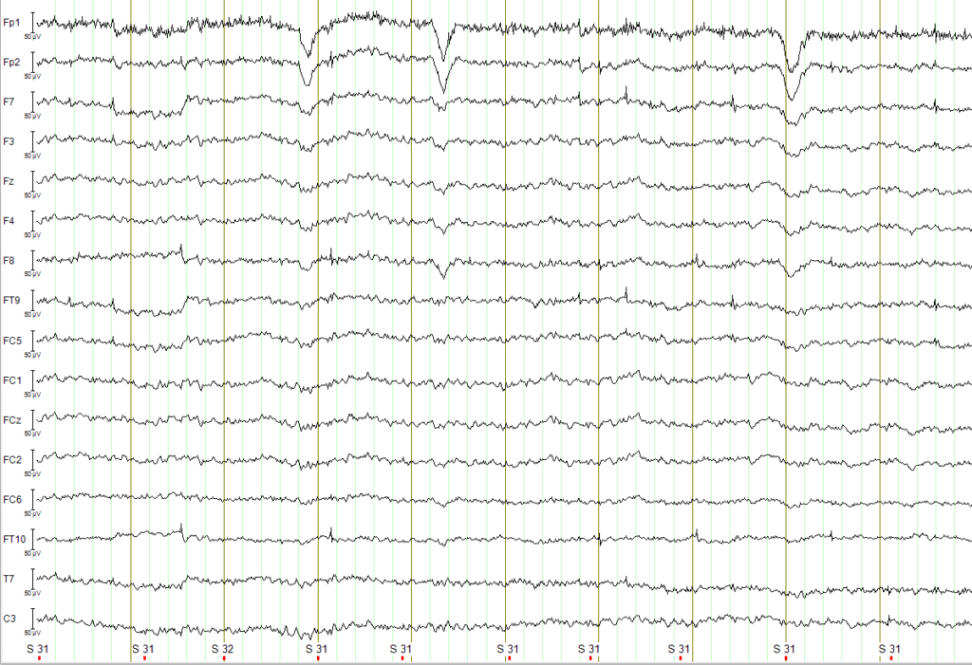
Neurophysiology of language processing
EEG/ERP
stimuli
Liang & Chen, 2022, p. 9
amplified
averaged (time-locked to the stimulus of interest)

Slide 5
Oddball paradigm
Oddball:
a sequence of frequently occurring standard stimuli interrupted by the occasional appearance of deviant stimuli)
MMN:
a negative-going wave deflection of frontocentral distribution with a peak at around 150-250 milliseconds from change onset.
P300 and LDN:
often following the MMN. P300 is associated with switch of attention, LDN involves additional cortical resources to extract the difference.
µV
Fz
LDN
-4
MMN
-2
0
2
4
-200
0
200
400
600
ms

Slide 6
Previous studies
MMN
Winkler et al. (1999): a similar MMN response to Finnish vowel contrast in native speakers of Finnish and a group Hungarian late learners of Finnish
(a naturalistic setting).
Peltola et al. (2003): a significant difference between native speakers of English and advanced Finnish students of English (a classroom setting).
Díaz et al. (2016): MMN was attenuated in poor L2 perceivers (the importance of individual speech-specific capabilities).
Liang and Chen (2022): different neural responses in adult Mandarin learners of English with high and low proficiency levels.

Slide 7
Research questions
Questions
Will any significant distinctions emerge in L3/Ln as opposed to L1 and L2?
Predictions
We predict the MMN to be stronger in native when compared with non-native speech (Jakoby et al., 2011; Liang & Chen, 2022; Näätänen et al., 1997; Song & Iverson, 2018)
The scale of the MMN effect in L2 when compared with L3/Ln is, however, impossible to predict due to the lack of previous studies which would focus on such a comparison
Will phonological contrasts be equally easy to detect and process in native and non-native langauges?
Will we observe any significant differences between formal and naturalistic learners?

Slide 8


Participants
AMU
23 participants:
formal langauge learners,
mean age = 22,55 (range: 18–38),
five males,
college students (N = 18),
AoA (English) = 5,86 years (range: 3–10),
AoA (Norwegian) = 20,27 years (range: 13–36),
Norwegian as chronologically the third (N = 9), the fourth (N = 11), the fifth (N = 1) or the sixth (N = 1) language
college graduates (MA, N = 4),

Slide 9
Experimental stimuli
Sounds
The Polish /ɨ/-/ɛ/ contrast was mainly manifested in height (and also exists in the other investigated languages).
The English /ɪ/-/ʊ/ contrast was mainly manifested in backness.
The Norwegian /i/-/ʏ/ contrast was mainly manifested in roundness.
Vowel | F1 | F2 | F3
/ɨ/ | 468 | 1948 | 2821
/ɛ/ | 675 | 1916 | 2722
/ɪ/ | 394 | 1828 | 2882
/ʊ/ | 390 | 1345 | 2896
/i/ | 357 | 1917 | 2587
/ʏ/ | 313 | 2015 | 2708

Slide 10
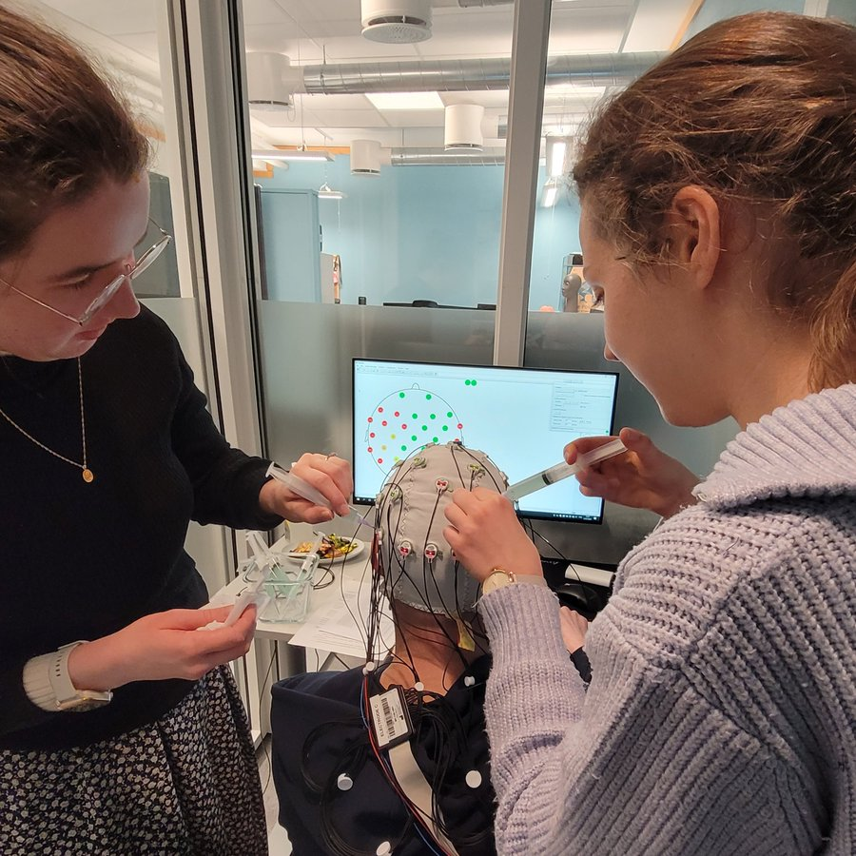
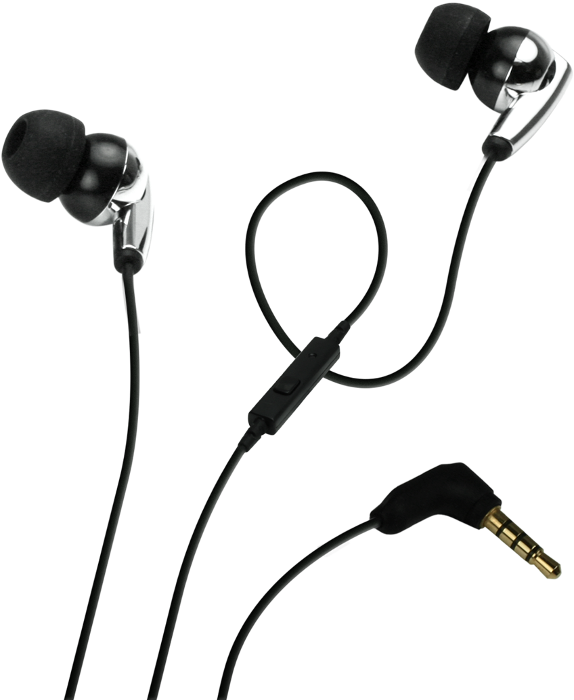

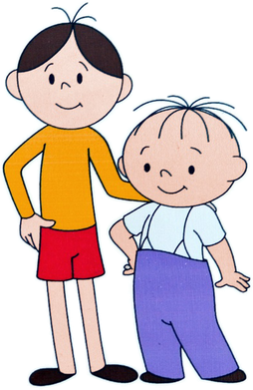
Procedure
Preparation
Experiment
Tests
consent, surveys
cap preparation
sound stimuli presentation
cartoon watching
langauge tests
gating task
BAG BEG

Slide 11

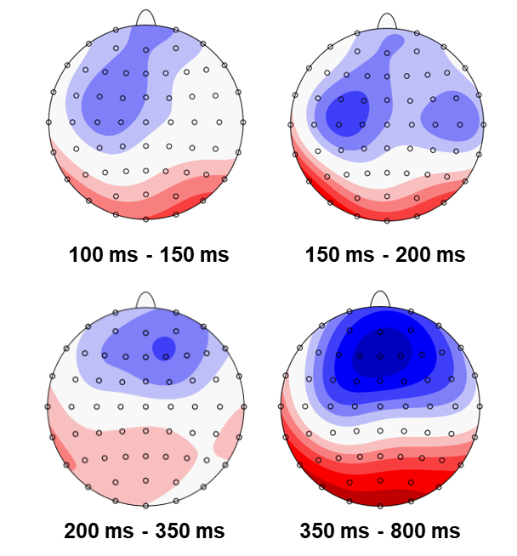
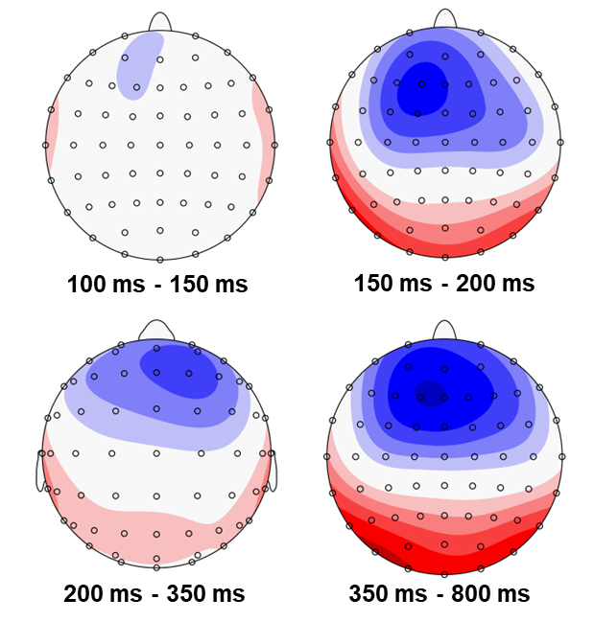
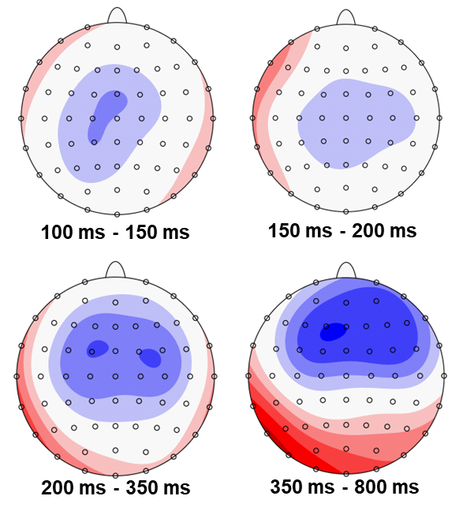
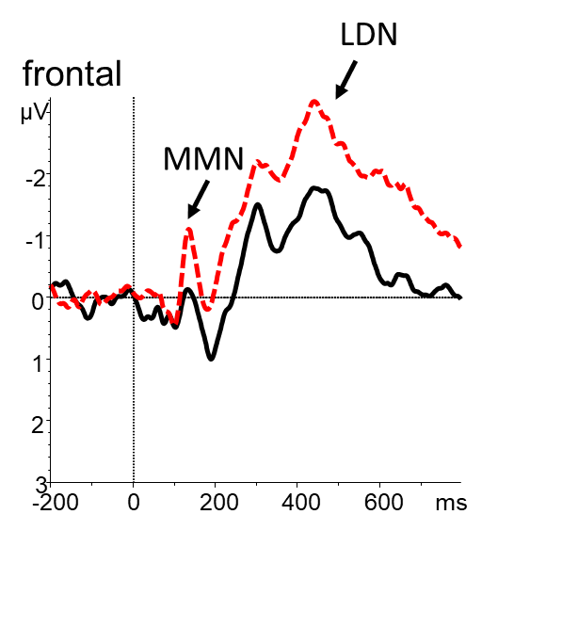
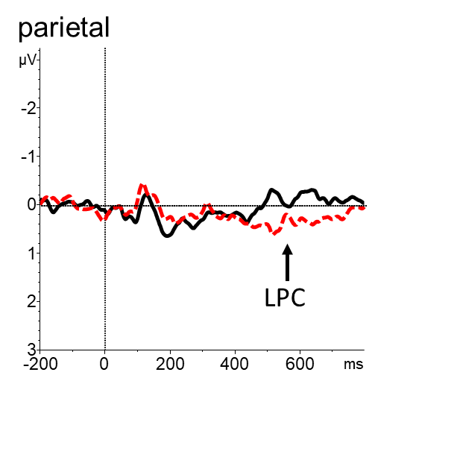
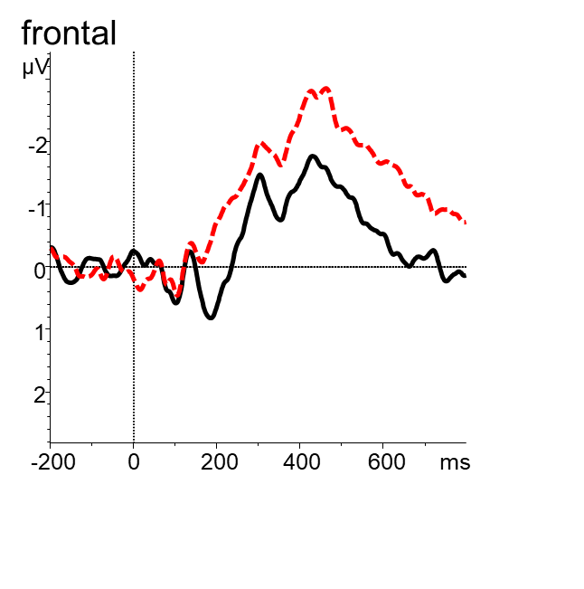
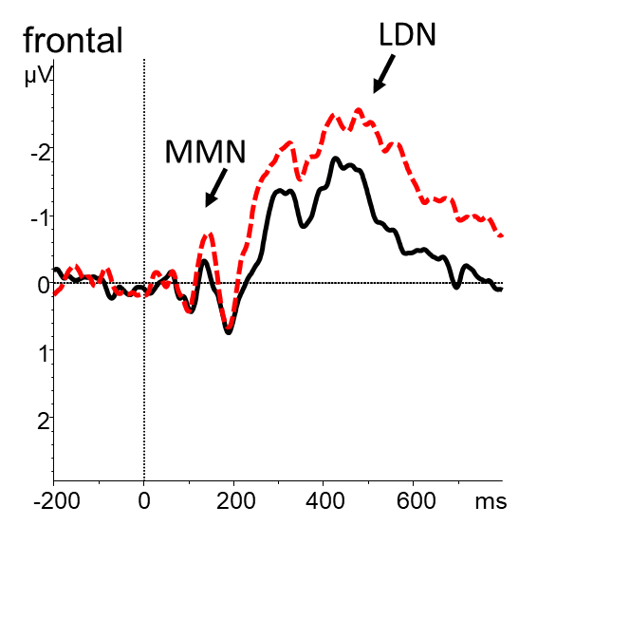
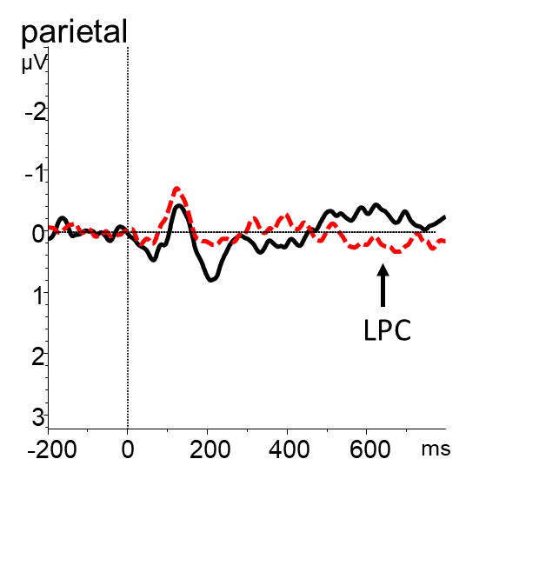
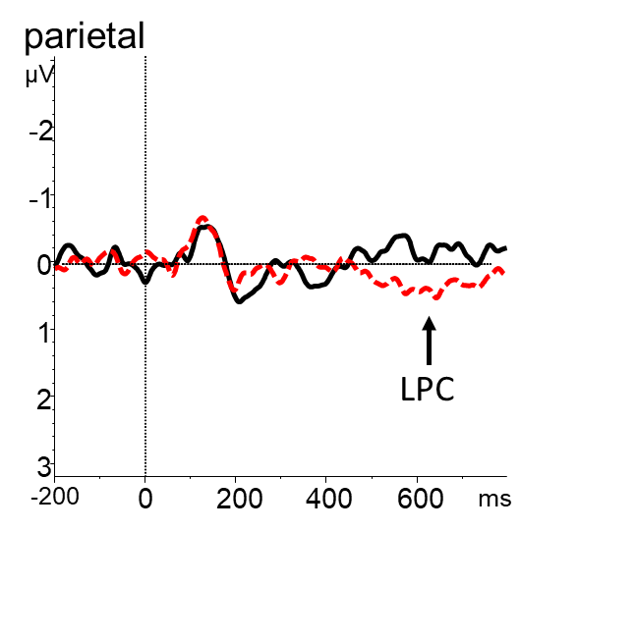
ERP results
LDN
L1 POLISH
L2 ENGLISH
L3/Ln NORWEGIAN

Slide 12
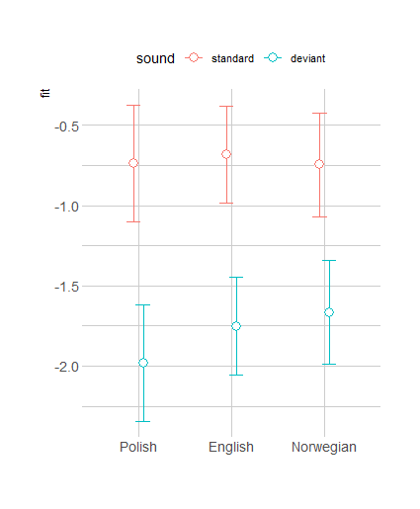
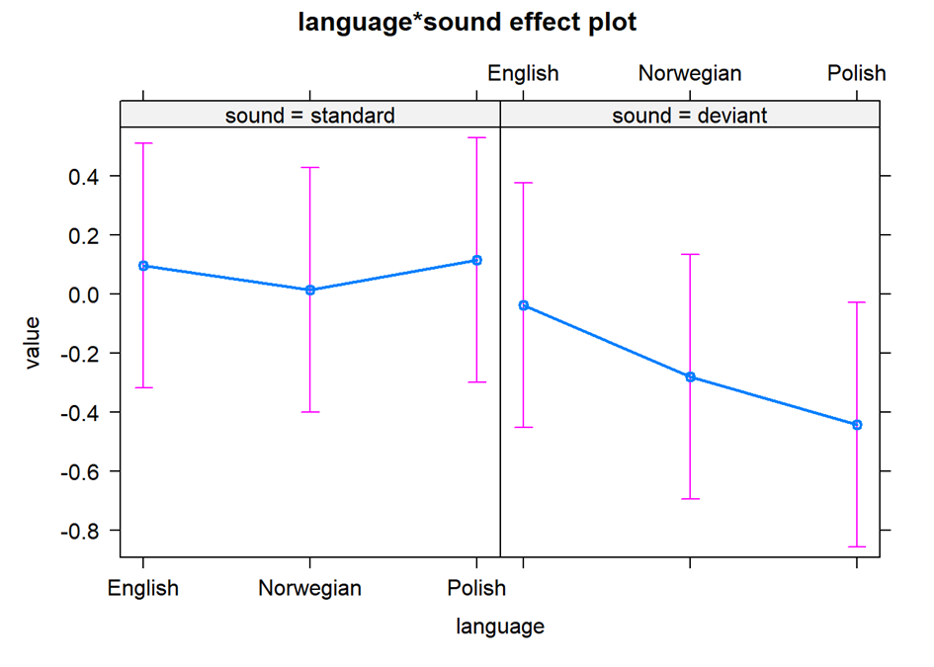
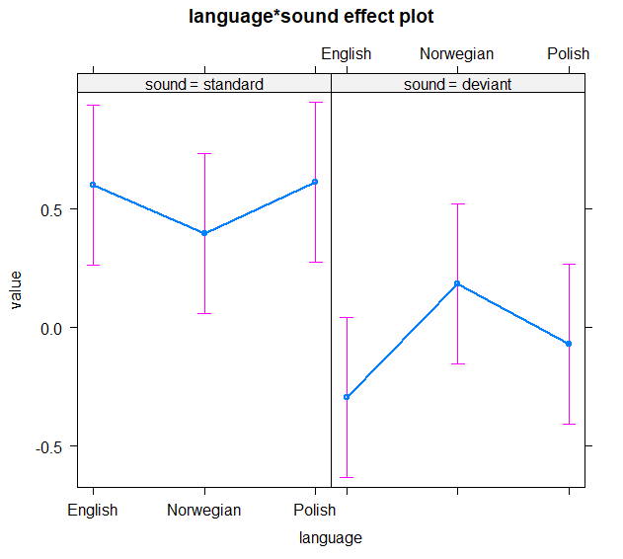
Result analysis
MMN
LDN
150-200
150-200

Slide 13
Discussion
Conclusion
We hypothesized that the response to the change would be deficient for non-native languages when compared to L1. This hypothesis was confirmed.
In addition, we have observed differences between L2 English and L3/Ln Norwegian. In the early 100-150 ms time window the MMN emerged in L3/Ln Norwegian but not in L2 English.
  This finding opens the discussion on the participants’ language dominance as a factor influencing phonemic perception mechanisms.
The LDN was less pronounced in L3 when compared with L1, but not with L2.
  This finding opens the discussion on the significance of LDN.
  While typically associated with pre-attentive cognitive evaluation of the stimulus (Jakoby et al., 2011), the component is also associated with extracting the phonological difference between STANDARD and DEVIANT or attention reorienting back to the original task (Escera et al., 2000).

Slide 14
Acknowledgements
This research has been supported financially by the Polish National Science Centre (NCN) in Poland.
ID nr: DEC-2019/34/H/HS2/00495
Period: Dec 2021-April 2024
PIs: Magdalena Wrembel, Marit Westergaard

Slide 15

Thank you
hanked@amu.edu.pl

