Slide 1
CLI in multilinguals: Do dominance and recency play a role?
Chloe Castle, Anna Skałba & Marit Westergaard

Slide 2
Agenda
A
The study
Participants
Design
Dominance scores
Hypotheses
Plans for analysis
Pilot results
Discussion

Slide 3
Primary Question
*dominance = use/activation of one language more of the time
**recency = experiment instructions and the language participants learn through
Do dominance* and recency** play a role in CLI at the initial stages of language acquisition?

Slide 4
Participants
Polish-English bilinguals living in Poland and England
Groups for analysis:
Dominance
Continuous scale for dominance (rather than grouping by England vs Poland – whilst L1 Polish speakers living in England may be expected to use English more than Polish speakers in Poland, this is not always necessarily true)
Recency
Polish-recency vs English-recency group

Slide 5
Constructions
Polish-like
English-like
Semantic gender
[garden image]
Han er vakker*
Det er vakker
Number agreement
[Lucas and Adam]
Lucas og Adam er store
Lucas og Adam er stor
Ditransitives
[Man showing a pencil to Simon]
Han viser blyanten til Simon
Han viser blyanten Simon
Articles
[Woman discovering a car]
Hun oppdager en bil
Hun oppdager bil
*this is used in some Northern Norwegian dialects

Slide 6
Study design
Vocabulary exposure of 36 lexical items
Picture-label matching task
Main experiment – forced-choice judgement task
Mini post-experiment task questionnaire
Proficiency task English
Proficiency task Polish
Language background questionnaire

Slide 7
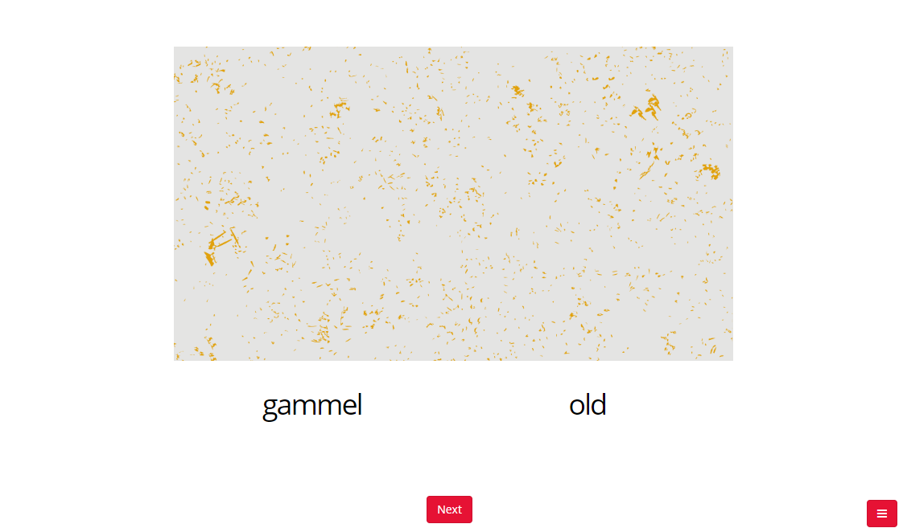
Vocab exposure
All lexical items were chosen very carefully to avoid lexical similarities between:
Norwegian and English
Norwegian and Polish
Norwegian and German (disguising the language so no choice can be made based on lexical similarity)
Gender of nouns are the same in Polish and Norwegian
No auditory stimuli – avoiding choices based on phonological similarity
Mandatory to do twice, can do as many times as desired after this

Slide 8
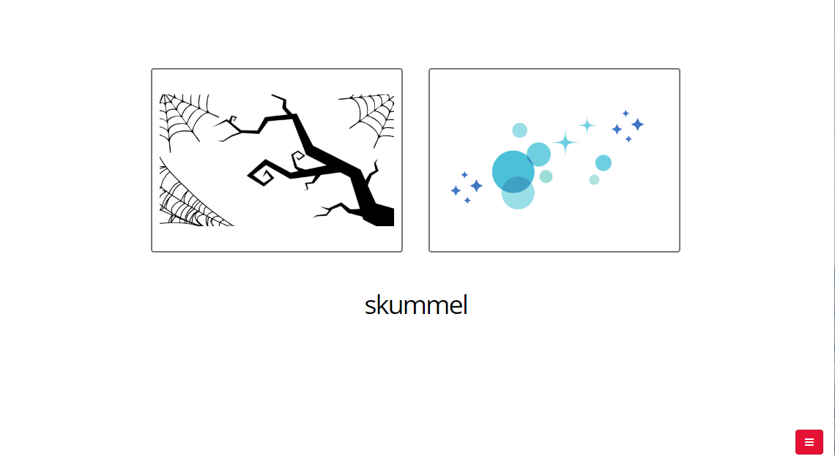
Picture label matching task
- Given two chances at this, if they get at least 80%, move on, if not, finish experiment there

Slide 9
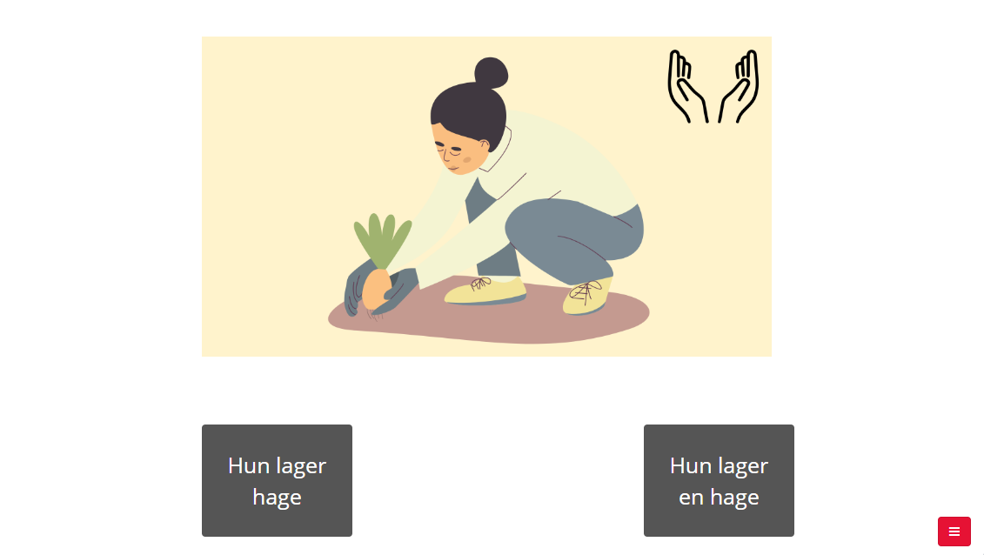
Main experiment – forced choice judgement task
18s to choose a sentence (mean + 2SD of pilot RT)
12 sentences for each construction:
Semantic gender (Pol-like)
Also semantic gender controls – for exclusion purposes (6 sentences)
Number agreement (Pol-like)
Ditransitives (Eng-like)
Articles (Eng-like)

Slide 10
Mini post-experiment task questionnaire
Which language they thought it was
Which language they were thinking in (perhaps to compare to ‘recency’)
What they think was being assessed
Whether they think the new language is more similar to Polish or English (to assess whether this may have an affect on what was chosen)

Slide 11
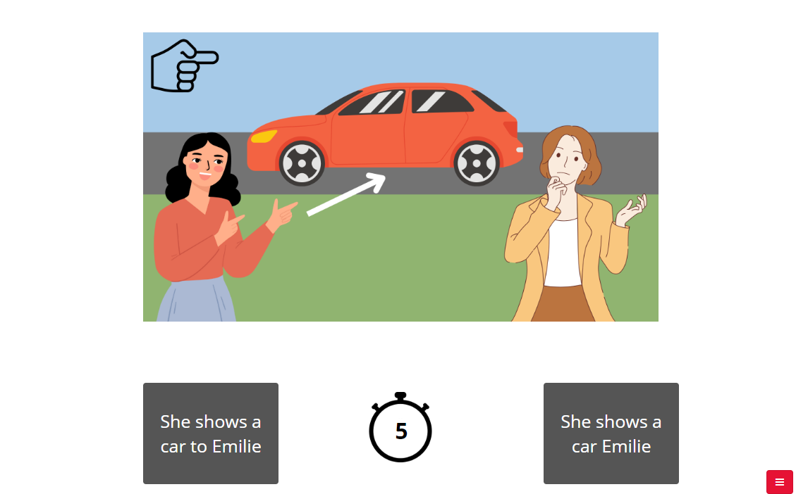
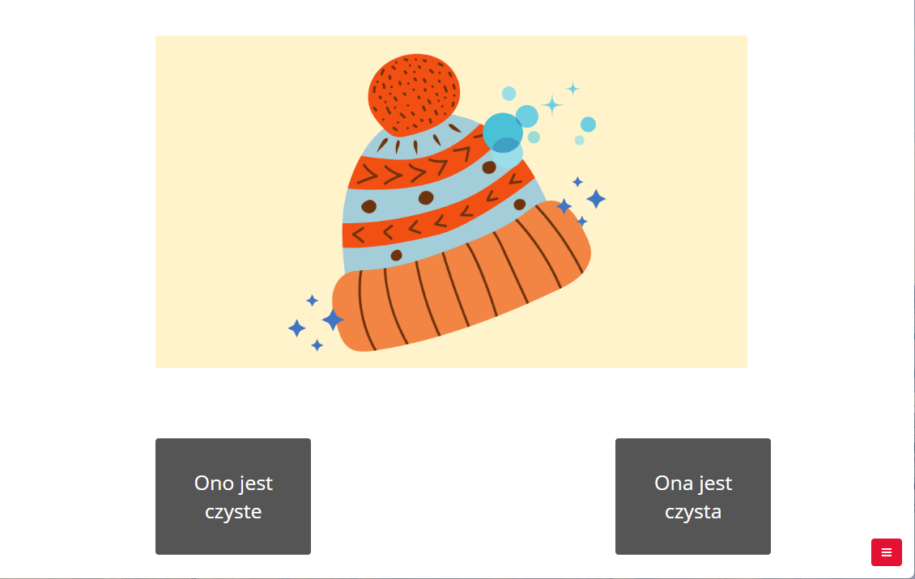
‘Proficiency tasks’ English and Polish
English
Same as the main task, with the English-like constructions (ditransitives and articles), 8s (mean +2SD)
Expect a high score – to show they know these constructions in English
Polish
Same as the main task, with the Polish-like constructions (number agreement and semantic gender), 8s (mean + 2SD)
Expect a high score – to show they know these constructions in Polish

Slide 12
Language background questionnaire – Dominance scales
2 scales:
Language and Social Background Questionnaire: a measure of degree of bilingualism
Assumption here that, e.g., more monolingual on the scale = more dominant in Polish (as L1), more bilingual = more dominant in English
Bilingual Language Profile: measure of language dominance

Slide 13
Language background questionnaire – Dominance scales
Why 2?
To more fully capture their language dominance:
Assess whether the results of the two scales correlate (?) – a different RQ?
LSBQ
More questions about language use in different domains
Can be used as a continuous variable (increased power)
Recognises that language control is dynamic
Adresses deficiencies of self-report through multiple questions that are demonstrated through the factor analysis to be reliably related
BLP
Includes questions about language attitudes
Each module is equally weighted to minimise risk of inflating any one factor
Continuous dominance score
Correlates significantly with performance on standardised proficiency tests
Can use both raw and calculated scores
Notes:
LSBQ – has more questions about language use in different domains (captures relevant aspects of multidimensional experience of bilingualism), can be used as a continuous variable (increased power), recognises that language control is dynamic, addresses deficiencies of self-report through multiple questions that are demonstrated through the factor analysis to be reliably related
BLP – includes questions about language attitudes, each module is equally weighted to minimise risk of inflating any 1 factor, continuous dominance score, correlates significantly with performance on standardised proficiency tests, can use both raw and calculated scores (language particular for each module, global scores for each language, composite dominance index)

Slide 14
Scoring - LSBQ
Enter in the values for each answer using the value legend
The composite score is automatically calculated
Pink column: higher score on this indicates greater second language* proficiency and use in private life, home and with family members
Blue column: higher score indicates more second language use in societal and community contexts
Purple: higher score = high Polish profiency, lower score = low Polish proficiency
Green: composite factor score, higher score = bilingualism**, lower = monolingualism
Participants with CFS below -3.13 classified as monolingual
Participants with CFS above 1.23 classified as bilingual
Those between may have ambiguous language backgrounds that cannot be classified as monolingual or bilingual eg receptive bilinguals
*second language = English here
**assumption = greater score, greater use of English

Slide 15
Scoring - BLP
Changed this to make the Language Proficiency questions /10 (to match with the LSBQ so we could have 1 questionnaire rather than 2)
Notes:
- About the questionnaire – how we created it

Slide 16
Hypotheses
H1.1: Those in the Polish recency group will select more Polish-like constructions than those in the English recency group
H1.2: Participants more dominant in Polish will choose more Polish-like constructions, and participants more dominant in English will choose more English-like constructions
Also wanting to assess how these may interact…
Expectations:
Polish-dominant = most Polish like constructions
English-dominant = most English-like constructions
Polish-recency = more Polish like constructions
English-recency = more English like constructions

Slide 17
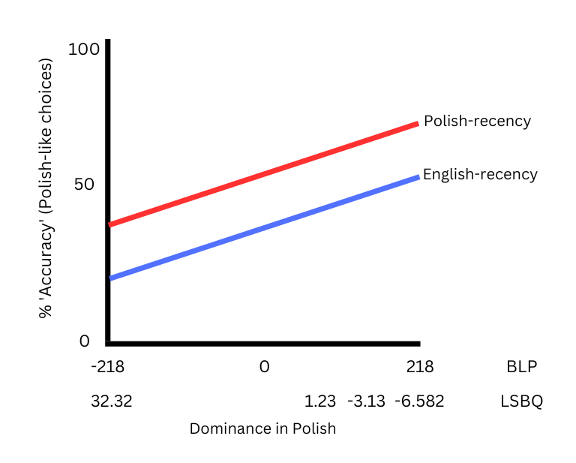
Hypotheses (graphed)

Slide 18
Plans for analysis
Model: Binomial mixed effects model
For dependent variable:
Overall Polish-like or English-like choices (labelled ‘accuracy’ = proxy for % Polish-like choices)
Independent variables:
Recency group (categorical)
Dominance (continuous)
LSBQ and BLP separately - and compare models in terms of explanation of variance (R²) – which explains variance better?
Range of LSBQ composite scores: -6.582 – 32.32
Range of BLP composite scores: -218 – 218
Looking at separate components of each of these instruments (e.g., language proficiency, social use)
Construction type (categorical)
Random effects
Random intercepts – subject, item
Random slopes – construction | subject
Exclude those who:
Do not do well in the English and Polish ‘proficiency tests’
Provide incorrect answers on the semantic_gender_control condition
Look into??
Whether the ‘language they were thinking in’ matched the ‘recency’ language
Developing the model:
Glmulti in R? – for the minimal adequate model (lowest Bayesian Information Criterion [BIC])
datadist - AIC for random effects inclusion in R?
Assessing outcomes:
Post-hoc relative importance test?
Assessing how much variance each predictor has explained (based on the assumption that the model selected as the optimal model has a justifiable fit to the data)
Predictors being: dominance and recency
Which dominance measure to use…
Pairwise comparisons?
Could be used to assess relationships in terms of construction type and dominance
Notes:
Accuracy ~ recency group + construction type + dominance
Dependent variable is binomial, categorical data
1 – regression analysis of the two, new variable expresses unexplained variance (BUT not wanting to change the numbers too much)
2 – compare models in terms of explanation of variance – look at Theres Gruter’s work, proficiency measure
Random effects
Intercepts – subject, item
Slopes – construction | subject

Slide 19
Pilot data – dominance + recency
English-recency have higher % English-like scores
English-recency
Participant no | 777 | 778 | 779 | 776
% Eng-like | 0.6875 | 0.791667 | 0.833333 | 0.875
LSBQ | 2.7 | 3.013 | 5.63 | 9.155
BLP | 57.938 | 75.646 | 41.012 | 7.896
Higher LSBQ = higher % English-like here…
Polish-recency
But not here…
Participant no | 811 | 813 | 814 | 812 | 815
% Eng-like | 0.541667 | 0.604167 | 0.6875 | 0.729167 | 0.770833
LSBQ | 5.8 | 4.45 | 8.29 | 2.48 | 9.96
BLP | 65.848 | 52.124 | 78.672 | 60.298 | 21.156
BLP scores not exactly in order in terms of % English-like…
Notes:
LSBQ= composite factor score, higher score = bilingualism** (more English use), lower = monolingualism
BLP = further from 0, less balanced (more dominant in one or the other)

Slide 20
Pilot data
LSBQ – removed those components which were absent for some participants and not others
English-recency
Participant no | 777 | 778 | 779 | 776
% Eng-like | 0.6875 | 0.791667 | 0.833333 | 0.875
LSBQ | 2.7 | 3.013 | 5.63 | 9.155
BLP | 57.938 | 75.646 | 41.012 | 7.896
LSBQ_no_blanks | 1.56 | 0.89 | 2.55 | 5.32
Aside from 1 participant in each group, higher % English-like = higher LSBQ
Participants must get higher LSBQ score in the Polish-recency condition to get a similar % Eng-like
Polish-recency
BLP issues:
Education question answered differently
Group were English linguistics students – very high attitude scores toward English
Participant no | 811 | 813 | 814 | 812 | 815
% Eng-like | 0.541667 | 0.604167 | 0.6875 | 0.729167 | 0.770833
LSBQ | 5.8 | 4.45 | 8.29 | 2.48 | 9.96
BLP | 65.848 | 52.124 | 78.672 | 60.298 | 21.156
LSBQ_no_blanks | 2.66 | 3.4 | 5.18 | 2.8 | 7.02
Also: participants guessed language similarity based on morphology (high level of linguistic knowledge as linguistics students)
Notes:
LSBQ= composite factor score, higher score = bilingualism** (more English use), lower = monolingualism
BLP = further from 0, less balanced (more dominant in one or the other)

Slide 21
Pilot data – across constructions
Polish Recency
English-like (higher values - English-like) | Articles | 0.616666667
 | Ditransitives | 0.766666667
Polish-like (higher values - Polish-like) | Number agreement | 0.583333333
 | Semantic gender | 0.133333333
 | Semantic gender - control | 0.866666667
English Recency
English-like (higher values - English-like) | Articles | 0.625
 | Ditransitives | 0.916666667
Polish-like (higher values - Polish-like) | Number agreement | 0.2
 | Semantic gender | 0.230769231
 | Semantic gender control | 0.958333333
Different across Recency groups
Perform differently for different constructions
Notes:
Performed about the same on articles
English recency group were more English-like on ditransitives
Polish recency group much more Polish-like on number agreement
Semantic gender – English recency group were more Polish-like…. Personal preferences? Or that the semantic gender condition is somewhat unique (‘it’ can also be used to describe an inanimate in Polish – ‘to’, but we translate it as ‘ono’ in the Polish version of the experiment, so then the on/ona form should always be used) – hard to say with such a small sample size

Slide 22
Current work
First data collection round: We have collected data from 30 people on Prolific (awaiting funds for 10 more), to be analysed
Second data collection round: Next few months

Slide 23
Let’s discuss
Tell us your ideas and recommendations!

