Slide 1

Genericity in second and third language acquisition
An overview of the ADIM project (WP4)
Marta Velnić
Roumyana Slabakova
Anne Dahl

Slide 2
Genericity: a brief overview
Expression of genericity is universal
No languages has a specific linguistic marker for marking genericity
Languages use readily available forms that also have other meanings
The meaning between existential and generic meaning is disambiguiated by context
Genericity is different from quantified NPs
Notes:
So what is the jist of what I just read?

Slide 3
Generic meanings (Krifka & Gernster 1987, Krifka et al. 1995)
Kind reference
Generic reference
Genericity comes from the DP
D-generics
extinct
Genericity comes from the whole sentence
Characterizing statement
I-generics
have a mane
Notes:
The kind reference predicate a property directly of the kind in question
Genericf reference expresses generalizations about individual members of the kind, iti s made true by enough individual members possessing the property

Slide 4
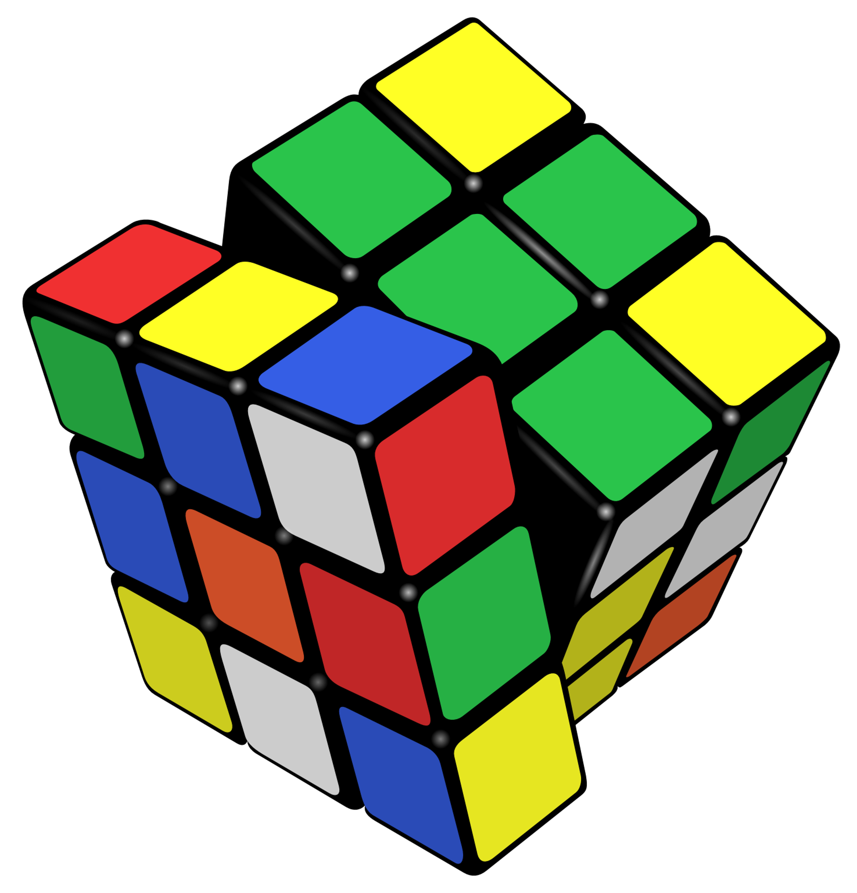
Genericity marking
Complexity of mapping between formal and semantic cues
Forms for existential meanings are also used to denote generic meanings
Complexity within languages and between languages
Morphosyntactic cues, pragmatic cues, and world knowledge
Notes:
There is no 1:1 mapping between form and meaning

Slide 5
Genericty as the default (Gelman & Raman, 2003)
Marked more by the absence of markers than by their presence
Many devices available within languages to mark the specific, to bound the NP in context
Generics are not pinned down to a context
Notes:
There is no 1:1 mapping between form and meaning

Slide 6
Form and generic meaning (in English)
Kind reference
Generic reference
The dinosaur is extinct
# A dinosaur is extinct
*Dinosaur is extinct
Dinosaurs are extinct
#The dinosaurs are extinct
The lion has a mane
A lion has a mane
*Lion has a mane
Lions have a mane
#The lions have a mane
Notes:
So, we will be looking at these forms across the three languages (well only 2 for polish)
As you see, there is no indefinite plural as none of the languages in the study have it.

Slide 7
Other meanings
Definite singular Anaphoric/unique (The dog in the kitchen is cute.)
Generic (The lion is a dangerous animal.)
Indefinite singular Non-specific indefinite (Everyone likes a cookie.)
Specific indefinite (A dog is sitting next to you.)
Generic (A cookie has lots of sugar.)
Bare plural/mass Non-specific indefinite (Marzipan has lots of sugar.)
Specific indefinite (Brown dogs are on the lawn.)
Generic (Cookies have lots of sugar.)
Notes:
So we have seen how various form in English can be generic, but ehre we see how these forms can also have other meanings.

Slide 8
Influence on the L2 and L3
Acquisition of generics: the task is not simply to acquire a particular form
Evidence that mapping of previously acquired languages can influence the mapping on the additional languages (Barton 2015, Kupisch 2012)
Notes:
This needs more material, or maybe it can be excluded.

Slide 9
Potential factors affecting acqusition
Types of expression: functional morphology or context
Ambiguity of a form
How many meanings are expressed in one form
Frequency of the form–meaning mapping in the input to learners
Dialectal differences
Age
Previous language experience
Notes:
Now, I haven’t of course referenced the full bibliography, but these are some of the factors that gave been put forth.

Slide 10
Potential factors affecting acqusition
Types of expression: functional morphology or context
Ambiguity of a form
How many meanings are expressed in one form
Frequency of the form–meaning mapping in the input to learners
Dialectal differences
Age
Previous language experience
Notes:
Now, I haven’t of course referenced the full bibliography, but these are some of the factors that gave been put forth.

Slide 11
What have we done so far?
Questionnaire in English, organized from form to meaning
Translated into Norwegian, Swedish, German, Turkish, Spanish, French, Russian, Bulgarian, Croatian and Arabic.
We have NOT worked yet on subtle cross-linguistic differences.
Polish is missing from the questionnaire
Notes:
So Polish is missing, btu I am working on that together with Pawel. The Questionnaire for Norwegian ahs been done, but it has some gaps, like the Norwegian bare singulars.
Also, we have to really be careful with the genrecis, for example I talked to some collegues and there seem to be differen jugmments ons entices like “The lions are dangerous” and “ The lions are dangerous when you poke them with a stick”

Slide 12
The ADIM project
Testing genericity in L3 acquisition
Participants
Adults | Adolescents
L1Polish | L1Polish-Norwegian
L2English | L3English
L3Norwegian
Notes:
Also we will need to find a proficiency test for Polish for the adolescents, because it is their HS.

Slide 13
Availability of forms (concrete nouns)
 | Def Sg | Indef Sg | Bare Sg | Bare Mass | Bare Pl | Def Pl
POL | X | √ | √ | √ | √ | X
ENG | √ | √ | X | √ | √ | √
NOR | √ | √ | √ | √ | √ | √
Notes:
Polish lacks articles, English does not allow for bare nouns, and Norwegian has all options. Since there is distinction between the available forms, these will map differently onto meaning.
Now, it is difficult to define a language in these kinds of binary distinction, whether it ahs a form or not, here I am representing this for concrete nouns only, as English does have bare singulars for expressing mass nouns, or abstracts,

Slide 14
 |  | Def.sg | Indef.sg | B.sg | B.pl | Def.Pl
Existential | Polish |  | √ | √ | √
 | English | √ | √ |  | √ | √
 | Norwegian | √ | √ | ≈ | X | √
Characterising | Polish |  | X | √ | √
 | English | √ | √ |  | √ | X
 | Norwegian | √ | √ | √ | √ | ?
Summary |  | POL≠ENG=NOR | POL≠ENG=NOR | POL=NOR≠ENG | POL=NOR=ENG
Kind | Polish |  | X | √ | √
 | English | √ | X |  | √ | X
 | Norwegian | √ | X | X | √ | √
Summary |  | POL≠ENG=NOR | POL=NOR=ENG | POL≠ENG≠NOR | POL=NOR=ENG | POL≠ENG≠NOR
Notes:
We are still working on this table , so this is not a complete representation.
The reason why I have a ? In the Def.pl for Norwegian charatcterising genricity, is that the def.pl was accepted to some extent in the preliminary task, but less than in half of the data points, so we have to look into more detail what is happening there .
So we cans ee that we have a full array of distinctions

Slide 15
 |  | Def.sg | Indef.sg | B.sg | B.pl | Def.Pl
Existential | Polish |  | √ | √ | √
 | English | √ | √ |  | √ | √
 | Norwegian | √ | √ | ≈ | X | √
Characterising | Polish |  | X | √ | √
 | English | √ | √ |  | √ | X
 | Norwegian | √ | √ | √ | √ | ?
Summary |  | POL≠ENG=NOR | POL≠ENG=NOR | POL=NOR≠ENG | POL=NOR=ENG
Kind | Polish |  | X | √ | √
 | English | √ | X |  | √ | X
 | Norwegian | √ | X | X | √ | √
Summary |  | POL≠ENG=NOR | POL=NOR=ENG | POL≠ENG≠NOR | POL=NOR=ENG | POL≠ENG≠NOR
Notes:
So we can see that we have almost a full array of distinctions , which I am colour coding here. We have the distinctions where Polish is different from the other two languages

Slide 16
 |  | Def.sg | Indef.sg | B.sg | B.pl | Def.Pl
Existential | Polish |  | √ | √ | √
 | English | √ | √ |  | √ | √
 | Norwegian | √ | √ | ≈ | X | √
Characterising | Polish |  | X | √ | √
 | English | √ | √ |  | √ | X
 | Norwegian | √ | √ | √ | √ | ?
Summary |  | POL≠ENG=NOR | POL≠ENG=NOR | POL=NOR≠ENG | POL=NOR=ENG
Kind | Polish |  | X | √ | √
 | English | √ | X |  | √ | X
 | Norwegian | √ | X | X | √ | √
Summary |  | POL≠ENG=NOR | POL=NOR=ENG | POL≠ENG≠NOR | POL=NOR=ENG | POL≠ENG≠NOR
Notes:
Then we see how English is the odd one out. In this case for the Bare sg

Slide 17
 |  | Def.sg | Indef.sg | B.sg | B.pl | Def.Pl
Existential | Polish |  | √ | √ | √
 | English | √ | √ |  | √ | √
 | Norwegian | √ | √ | ≈ | X | √
Characterising | Polish |  | X | √ | √
 | English | √ | √ |  | √ | X
 | Norwegian | √ | √ | √ | √ | ?
Summary |  | POL≠ENG=NOR | POL≠ENG=NOR | POL=NOR≠ENG | POL=NOR=ENG
Kind | Polish |  | X | √ | √
 | English | √ | X |  | √ | X
 | Norwegian | √ | X | X | √ | √
Summary |  | POL≠ENG=NOR | POL=NOR=ENG | POL≠ENG≠NOR | POL=NOR=ENG | POL≠ENG≠NOR
Notes:
We also have cases whehre all three langauges have the same form to meaning mapping

Slide 18
 |  | Def.sg | Indef.sg | B.sg | B.pl | Def.Pl
Existential | Polish |  | √ | √ | √
 | English | √ | √ |  | √ | √
 | Norwegian | √ | √ | ≈ | X | √
Characterising | Polish |  | X | √ | √
 | English | √ | √ |  | √ | X
 | Norwegian | √ | √ | √ | √ | ?
Summary |  | POL≠ENG=NOR | POL≠ENG=NOR | POL=NOR≠ENG | POL=NOR=ENG
Kind | Polish |  | X | √ | √
 | English | √ | X |  | √ | X
 | Norwegian | √ | X | X | √ | √
Summary |  | POL≠ENG=NOR | POL=NOR=ENG | POL≠ENG≠NOR | POL=NOR=ENG | POL≠ENG≠NOR
Notes:
And also cases where the three languages are different. We are still testing the Def.pl in Norwegian for the characterising reading, but it is accepted to some extent, which makes it different from English
We are missing within genericity a condition where Norwegian is different, but we might include existentials as controls and test it there.

Slide 19
Example Def plural ENG ≠ NOR
(1) Dinosaurene er utryddet. D-generic
dinosaur-DEF.PL are extinct
(2) Sebraene har striper. I-generic
zebra-DEF.PL have stripes
(3) #The dinosaurs are extinct NO kind reference
(4) The zebras have stripes. Only episodic
Notes:
Here I am taking examples from our exploratory task conducted on native speakers of Norwegian. The D-generic was accepted to a high degree, the I.generics in this category to a lesser degree, but this particular example was accepted as generic by 72% of the participants.
These examples differ also from polish as Polish does not have articles.

Slide 20

Example Bare plural ENG ≠ NOR
(1) Elks are not in danger of extinction. Kind
(2) #Elger står ikke i fare for å bli utryddet. NO Kind reading
‘Elks are not in danger of extinction.’
(3) Elg-er er flotte dyr / pattedyr /har fire bein.
Elk-PL are magnificent animals/mammals/have four leg
‘Elks are magnificent animals/mammals/have four legs.’
Notes:
Also here, it seems that the bare plural is always generic, I did not encounter any issues wiutht he judgments, so we have to be careful.

Slide 21
Bare singulars ENG ≠ NOR
(5) Det er sunt å ha hund/*hunden/?en hund/ hunder/*hundene
It is healthy to have dog.
(Almost) only appear in object position, or underlying objects, not Agents.
A restricted set of verbs (have verbs)
Type denoting
Notes:
A not ion bare singulars, these refer to concrete countable nouns. Mass nouns can also be bare but they are not a bare singular.
So regarding the example, the most natural way to say this is with the Bsg- the other available options signal subtle changes in meaning: the indefinite means to literally have one dog, more dogs might not be healthy to have, the bare plural on the other hand means that it is healthy to have plurality of dogs as opposed to one. So they are also generic, but have a more restricted meaning than the B.sg, which is the meaning we are going for.
These examples are similar in polish and Norwegian

Slide 22
Possible additional item
Abstract singulars (marriage-type nouns)
Bare in English (generic reading), but need the definite article in Norwegian (ambiguous between generic and existential)
Bare in Polish- no articles (and ambiguous)
Małżeństwo jest trudne/ Ekteskapet er vanskelig/Marriage is hard
Bare.sg Def .sg Bare.sg
Notes:
But also with these, the situation is more complicated than what we would have liked. We tested two nouns in a generic contexts: childhood and marriage. And while childhood was highly accepted with the Def.sg, marriage was accepted only half of the time. Both were accepted as Bsg to different degrees. So the questions is: if there is variation within the category, if it is acquisition or is it route learning. So we are unsure whether this item would be useful. It would be great as Polish and English are similar here, and Norwegian is the odd one out.

Slide 23
Predictions
 | L3 Nor |  | L3 Eng
 | Kind | Char | Kind | Char
Def.sg | (+)ENG | (+)ENG | (+)NOR | (+)NOR
Indef.sg | (+)ENG (-)POL | (+)ENG (+)POL | (+)NOR (-)POL | (+)NOR (+)POL
B.sg | (-)POL | (+)POL | (-)NOR (-)POL | (-)NOR (-)POL
Bare.pl | (+)ENG (+)POL | (+)ENG (+)POL | (+)ENG (+)POL | (+)ENG (+)POL
Def.pl | (-)ENG | (-)ENG | (-)NOR | (-)NOR
Notes:
MAKE NEW TABLE!
So this is a table representing the factors, but I am still not completely sure about that,

Slide 24
The task
Online testing
3 separate tasks: AJT for singulars, AJT for plurals, and a production task
AJT as a forced choice task
We will measure response and RTs (possibly also mouse tracking)
Notes:
So we are now in the planning phase and a lot of things are still TBD, but we are making progress.

Slide 25


Example
I går lærte jeg at mange dyrearter på jorda er utrydda. For eksempel er det slik at...
Notes:
Rhis is an example of how we might set it up. They will read the context sentence first, when they have read it they will click. And then choose, we will start measuring RTs after the click.
As you see, the target NP is not meantioned in the cotnexts as we do not want to investigate definiteness.
Here there is a choice between def.sg and Indef.sg, we will have the B.sg form within this task, but we still need to think how to distribute the items.
Both sets of AJTs should work the same.

Slide 26
Example
I går lærte jeg at mange dyrearter på jorda er utrydda. For eksempel er det slik at...
Notes:
Rhis is an example of how we might set it up. They will read the context sentence first, when they have read it they will click. And then choose, we will start measuring RTs after the click.
As you see, the target NP is not meantioned in the cotnexts as we do not want to investigate definiteness.
Here there is a choice between def.sg and Indef.sg, we will have the B.sg form within this task, but we still need to think how to distribute the items.
Both sets of AJTs should work the same.

Slide 27
Example
I går lærte jeg at mange dyrearter på jorda er utrydda. For eksempel er det slik at...
dodoen er utryddet
en dodo er utryddet
Notes:
Rhis is an example of how we might set it up. They will read the context sentence first, when they have read it they will click. And then choose, we will start measuring RTs after the click.
As you see, the target NP is not meantioned in the cotnexts as we do not want to investigate definiteness.
Here there is a choice between def.sg and Indef.sg, we will have the B.sg form within this task, but we still need to think how to distribute the items.
Both sets of AJTs should work the same.

Slide 28
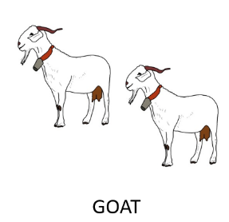

Production task
Participants must complete an unfinished answer on the basis of a question, an image-pair and a given word. (Miller 2016)
In the world, there are many animals that have horns (but many others don’t).
SWALLOW
What animals have horns?
___________ have horns. Expected answer: Goats
Notes:
This task is currently the least though of . This task should elicit both generic and existential statements.

Slide 29

Fillers
Definiteness fillers for AJT on singulars
Existential fillers for AJT on plurals
Mary has two dogs and a cat.
Yesterday the cat…
Yesterday a cat…
(Ionin & Montrul, 2010)
Notes:
We need to make sure that the participants know the article system, so we have to check if they even have the articles system in place.

Slide 30
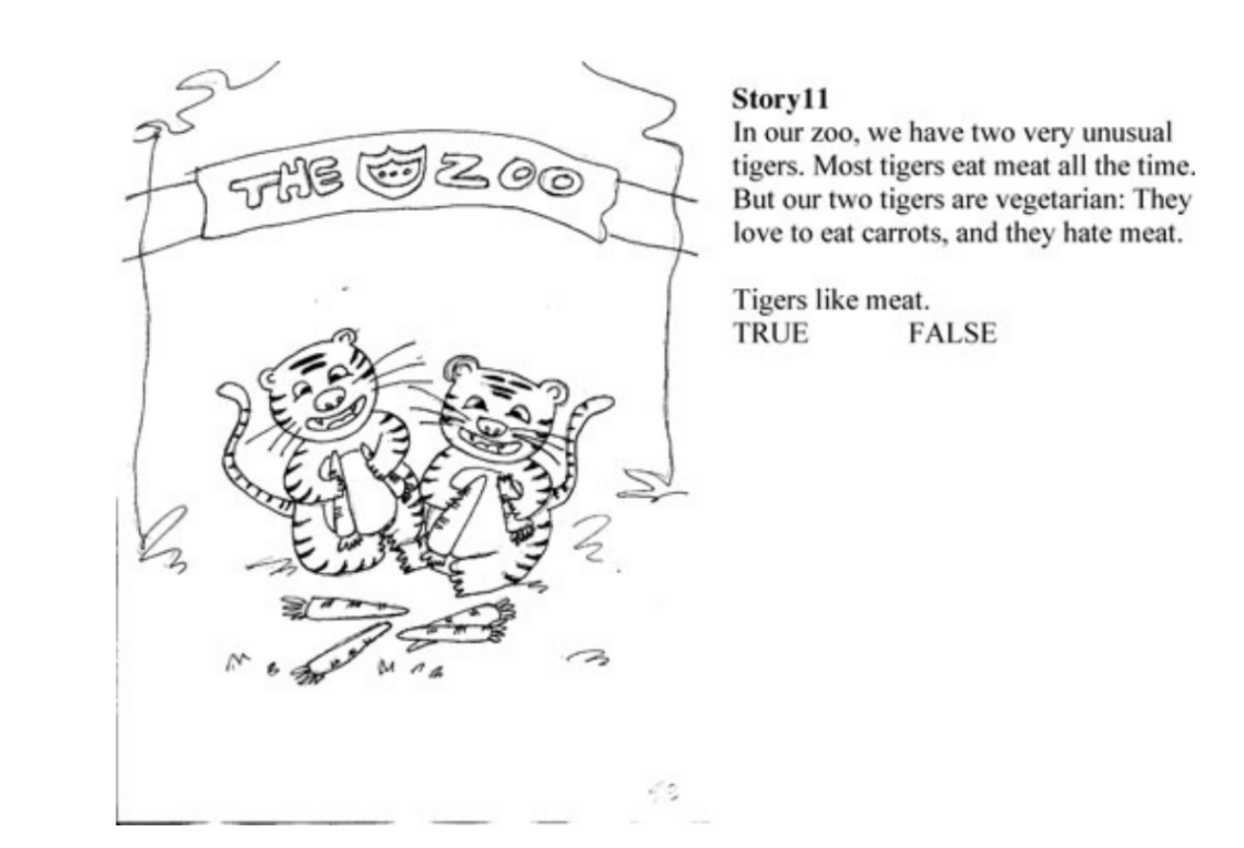
Fillers
Definiteness fillers for AJT on singulars
Existential fillers for AJT on plurals
Tigers like carrots.
The tigers like carrots.
(Ionin & Montrul, 2010)
Notes:
And for the existential fillers, we take inspiration from one of the Ionin studies, but in our filler items the existential reading would be the correct one, so in both English and Norwegian we would expect Def-pl to be chosen.

Slide 31
References
Barton, D., Kolb, N., & Kupisch, T. (2015). Definite article use with generic reference in German: an empirical study. Zeitschrift für Sprachwissenschaft, 34(2), 147-173.
Borthen, K. (2003). Norwegian bare singulars. Det historisk-filosofiske fakultet.
Gelman, S. A., & Raman, L. (2003). Preschool children use linguistic form class and pragmatic cues to interpret generics. Child Development, 74(1), 308-325.
Halmøy, M. (2016). The Norwegian Nominal System. In The Norwegian Nominal System. De Gruyter Mouton.
Ionin, T., & Montrul, S. (2010). The role of L1 transfer in the interpretation of articles with definite plurals in L2 English. Language Learning, 60(4), 877-925.
Krifka, M. (1995). Focus and the interpretation of generic sentences. The generic book, 238, 264.
Krifka, M., & Gerstner, C. (1987). An outline of genericity.
Kupisch, T. (2012). Specific and generic subjects in the Italian of German–Italian simultaneous bilinguals and L2 learners. Bilingualism: Language and Cognition, 15(4), 736-756.
Miller, L. E. (2016). The acquisition of bare nominals by three populations of Spanish-English bilingual adults Purdue University].

