Slide 1
Acoustic and perceptual similarity of L2 English and L3 Norwegian vowels to L1 Polish categories
Anna Balas, Jarosław Weckwerth, Magdalena Wrembel and Kamil Kaźmierski
Poznań Linguistic Meeting 2022
NEW Approaches to the Study of Sound Structure
and Speech. A special session in honour of
Prof. Katarzyna Dziubalska-Kołaczyk.

Slide 2
The Approaches connection
Ten female speakers of Polish
Collegium Novum, Poznań
All six Polish vowels
Carrier: Ola powiedziała słowo X ‘Ola said the word X’
X = /b–tɨ/ or /t–ra/
/a/ and /ɛ/ in palatal contexts
Average F1, F2, F3 over central vowel portion measured

Slide 3
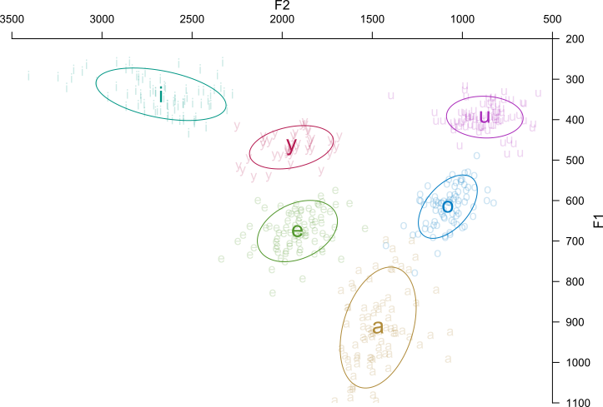
Reference Polish vowels

Slide 4
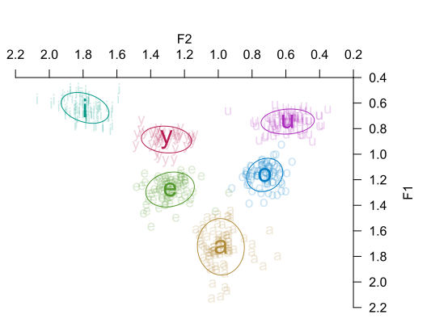
Reference Polish vowels

Slide 5
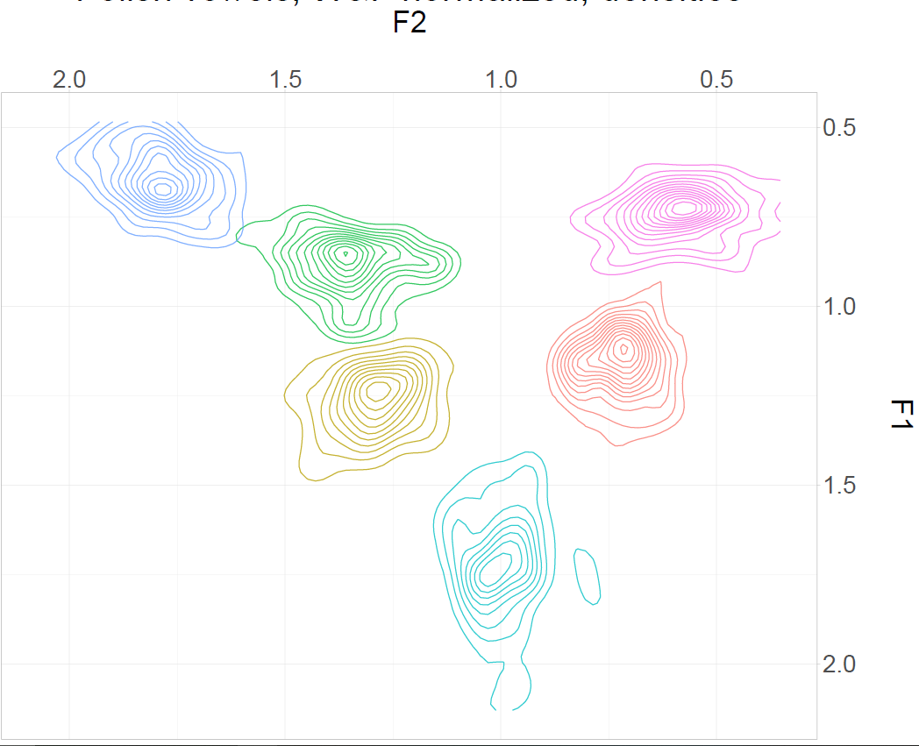
Reference Polish vowels

Slide 6
The implementation of the reference values in research on the relationship of acoustic and perceptual similarity
In the present contribution, we want to explore the relationship between L2 and L3 perception and acoustic similarity operationalized as the Euclidean distance between L2 English/L3 Norwegian and L1 Polish vowels.

Slide 7
Non-native speech perception
So far non-native vowel perception studies concentrated on L2:
Perceptual assimilation and discrimination (Best and Tyler 2007, Tyler et al. 2014)
The relationship between vowel perception and acoustic parameters (Escudero, Simon, Mitterer 2012)
The role of language dominance (Amengual and Chamorro 2015)

Slide 8
Euclidean distance
Euclidean distance between vowels: the distance between two points in vowel space (Hz).
May be two-dimensional or three-dimensional: F1-F2 or F1-F2-F3.
Source: https://en.wikipedia.org/wiki/Euclidean_distance

Slide 9
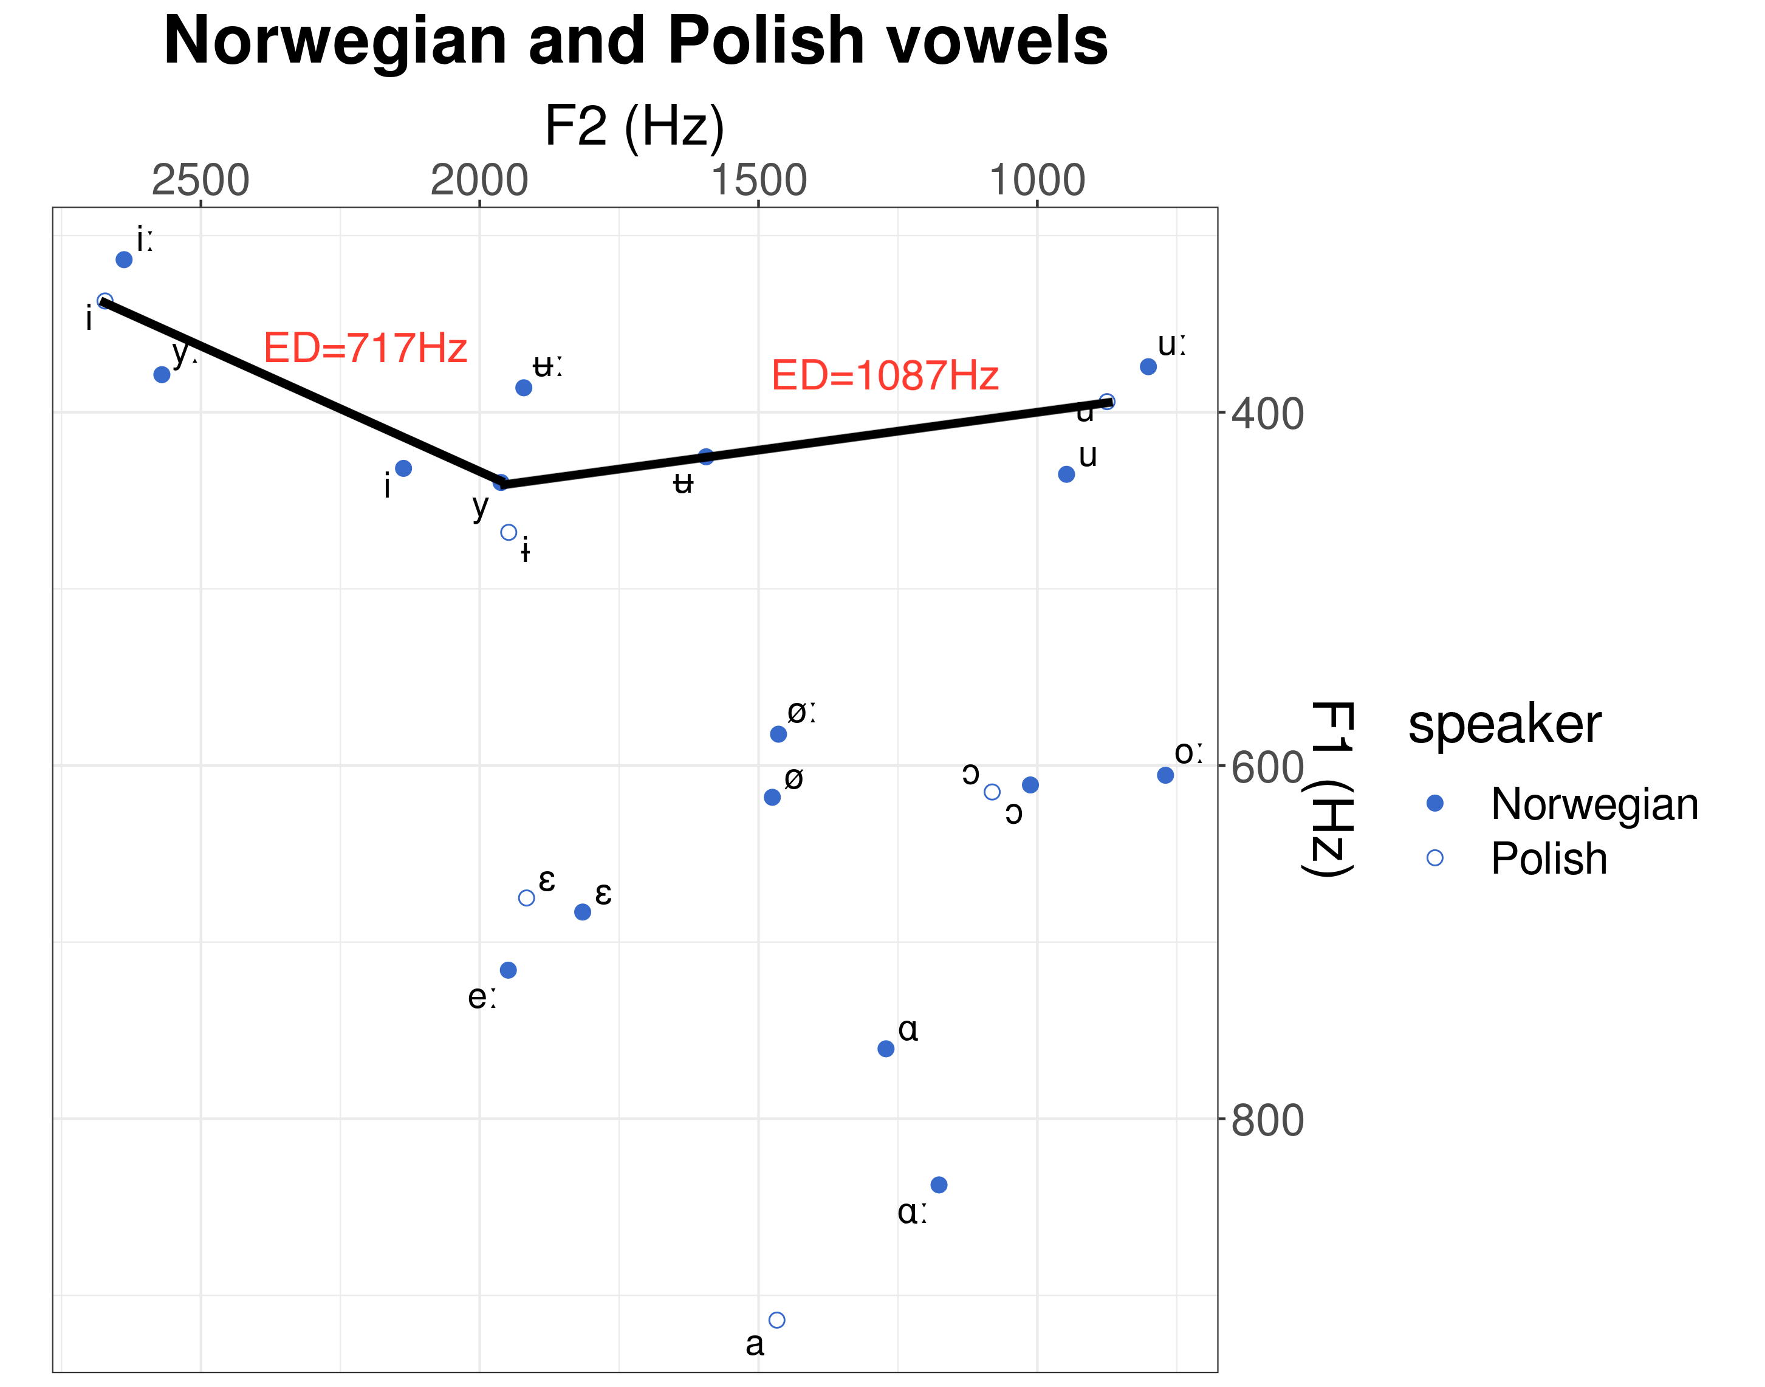

Slide 10
Hypotheses
H1: The smaller the Euclidean distance between two vowels, the higher the likelihood of assimilating a given L2 English/L3 Norwegian vowel to a L1 Polish vowel category.
H2: Lip rounding and duration differences may influence assimilation patterns.
H3/RQ: Does the Euclidean distance predict assimilation better in L2 or L3?
H4: If we take into account the Euclidean distance, L2 vowels should be perceived as worse exemplars of L1 categories than L3 vowels.

Slide 11
Methodology: Participants
Participants: 24 L1 Polish, L2 English (advanced, mean of language learning duration: 12.23), L3 Norwegian (2 months of intensive instruction). Mean age: 19.86. 17 females, 7 males. Instructed setting.

Slide 12
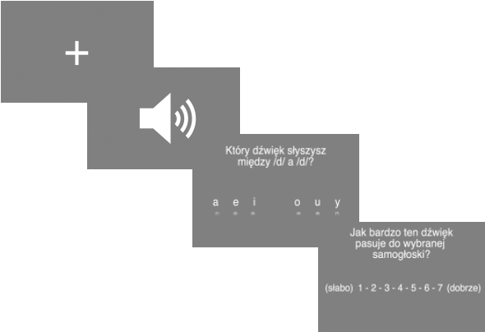
Methods: Stimuli & procedure
Participants assimilated 10 English and 16 Norwegian monophthongs (in separate blocks, on separate days) embedded in nonce words /dVd/ to six Polish vowel categories (orthographic labels were used, as Polish orthography is transparent).
Each stimulus was played three times.
They also rated the goodness of fit of each non-native vowel to the chosen L1 category.
Likert scale from 1 to 7.

Slide 13
Results: Confusion matrix
 | /a/ | /e/ | /i/ | NA | /ɔ/ | /u/ | /ɨ/
TID /iː/ |  |  | 100%
 |  |  | 5,77
FIN /i/ |  | 26.39% | 33.33% | 1.38% |  | 1.38% | 37.5%
 |  | 5.21% | 5 | 4 |  | 3 | 5.41%
LYS /yː/ |  | 1.39% | 70.83% |  |  | 4.17% | 23.61%
 |  | 1 | 4.59 |  |  | 4.33 | 5
SYND /y/ |  | 8.33% | 16.66% | 1.39% | 2.78% | 8.33% | 62.5%
 |  | 5.17 | 5.25 |  | 5 | 2.33 | 4.64
STED /eː/ | 6.94% | 88,89% |  | 2,78% | 1,39%
 | 5.6 | 5.14 |  | 4 | 2
BEST /e/ | 5.56% | 93.06% | 1.39%
 | 5 | 5.9 | 2
LØP /øː/ | 5.56% | 19.44% |  |  | 58.33% | 6.94% | 9.72%
 | 3.75 | 5.14 |  |  | 4.45 | 3.2 | 3.57
SØNN /øː/ | 8.33% | 36.11% |  | 4.17% | 33.33% | 6.94% | 11.11%
 | 5 | 4.35 |  | 5.33 | 4.29 | 3.2 | 3.25
 | /a/ | /e/ | /i/ | NA | /ɔ/ | /u/ | /ɨ/
DAG /ɑː/ | 100,00%
 | 5.53
TAKK /ɑ/ | 98.61% |  |  | 1.39%
 | 5.69 |  |  | 4
RAD /oː/ |  |  | 1.39% |  | 97.22% | 1.39%
 |  |  | 5 |  | 5.25 | 7
NOK /o/ |  |  |  | 1.39% | 98.61%
 |  |  |  |  | 5.58
BOK /uː/ |  |  |  |  | 38.89% | 61.11%
 |  |  |  |  | 5.43 | 5.02
ROM /u/ |  |  |  |  | 72.22% | 27.78%
 |  |  |  |  | 5.08 | 4.9
GUD /ʉː/ |  | 1.39% | 2.78% | 1.39% | 1.39% | 75% | 18.06%
 |  | 1 | 7 | 5 | 5 | 4.72 | 4.23
SLUTT /ʉ/ |  |  | 1.39% | 1.39% | 9.72% | 63.89% | 23.61%
 |  |  | 3 | 7 | 5 | 4.65 | 4.11

Slide 14
 | /a/ | /e/ | /i/ | NA | /ɔ/ | /u/ | /ɨ/
TID /iː/ |  |  | 100%
 |  |  | 5,77
LYS /yː/ |  | 1.39% | 70.83% |  |  | 4.17% | 23.61%
 |  | 1 | 4.59 |  |  | 4.33 | 5
SYND /y/ |  | 8.33% | 16.66% | 1.39% | 2.78% | 8.33% | 62.5%
 |  | 5.17 | 5.25 |  | 5 | 2.33 | 4.64
GUD /ʉː/ |  | 1.39% | 2.78% | 1.39% | 1.39% | 75% | 18.06%
 |  | 1 | 7 | 5 | 5 | 4.72 | 4.23
SLUTT /ʉ/ |  |  | 1.39% | 1.39% | 9.72% | 63.89% | 23.61%
 |  |  | 3 | 7 | 5 | 4.65 | 4.11

Slide 15
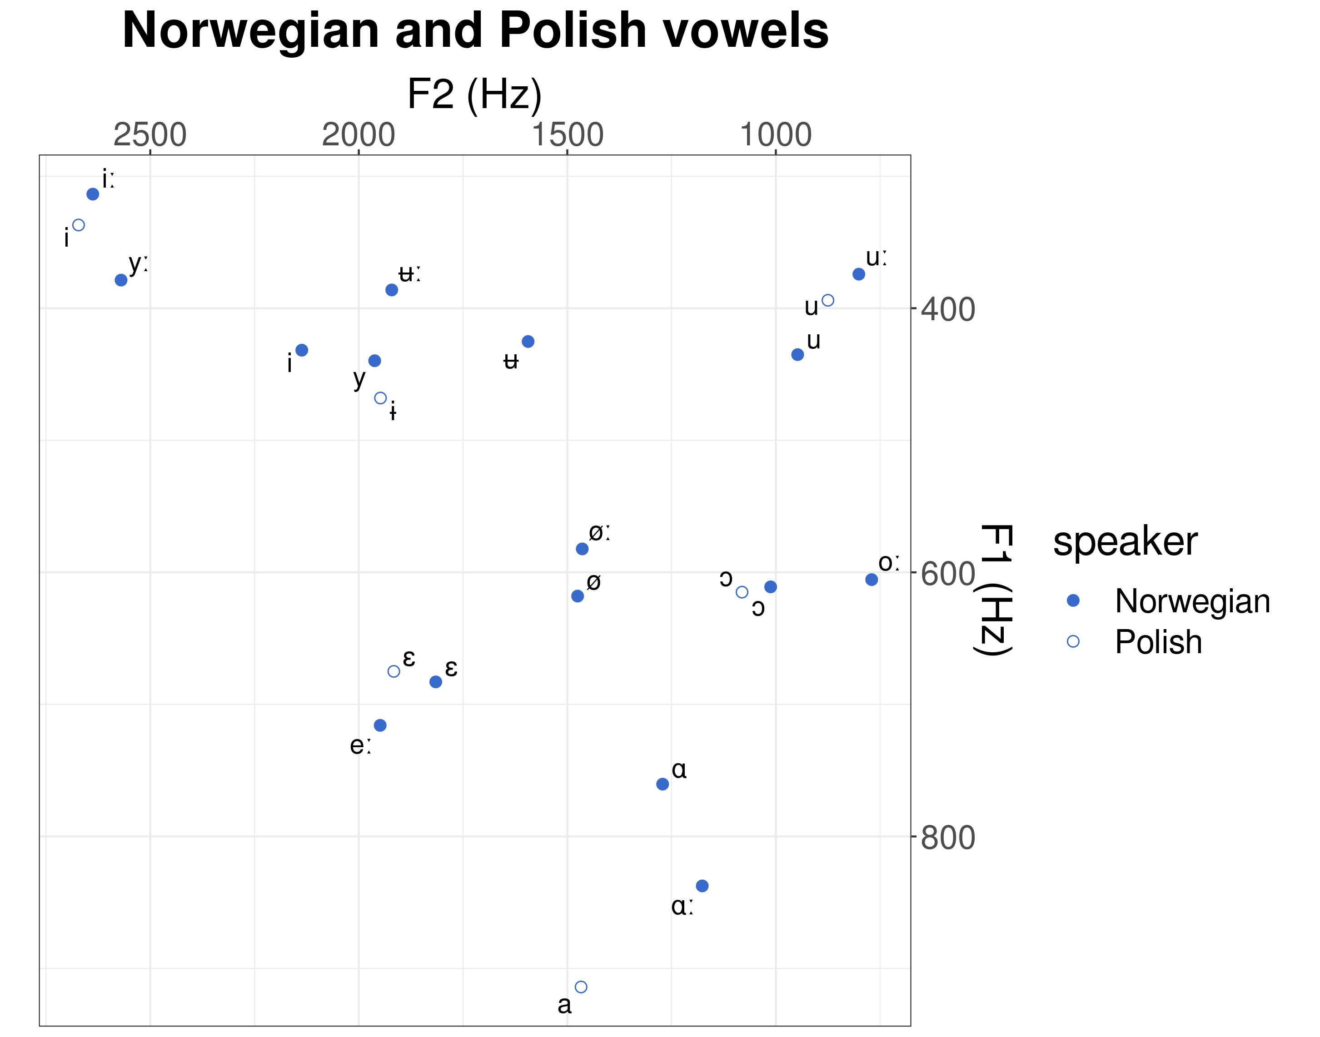

Slide 16
The smaller the ED, the higher the likelihood of assimilation
A negative binomial model was used to capture whether:
the F1-F2 Euclidean distance is related to how often a given Norwegian vowel is assimilated to a given Polish vowel?
The impact of Euclidean distance is different for short vs. long vowels?
Result: ED is negative and significant (z = -6.751, Pr(>|z|) = 1.46e-11***), which means that the larger the Euclidean distance, the fewer assimilations are predicted. H1 has been supported.

Slide 17
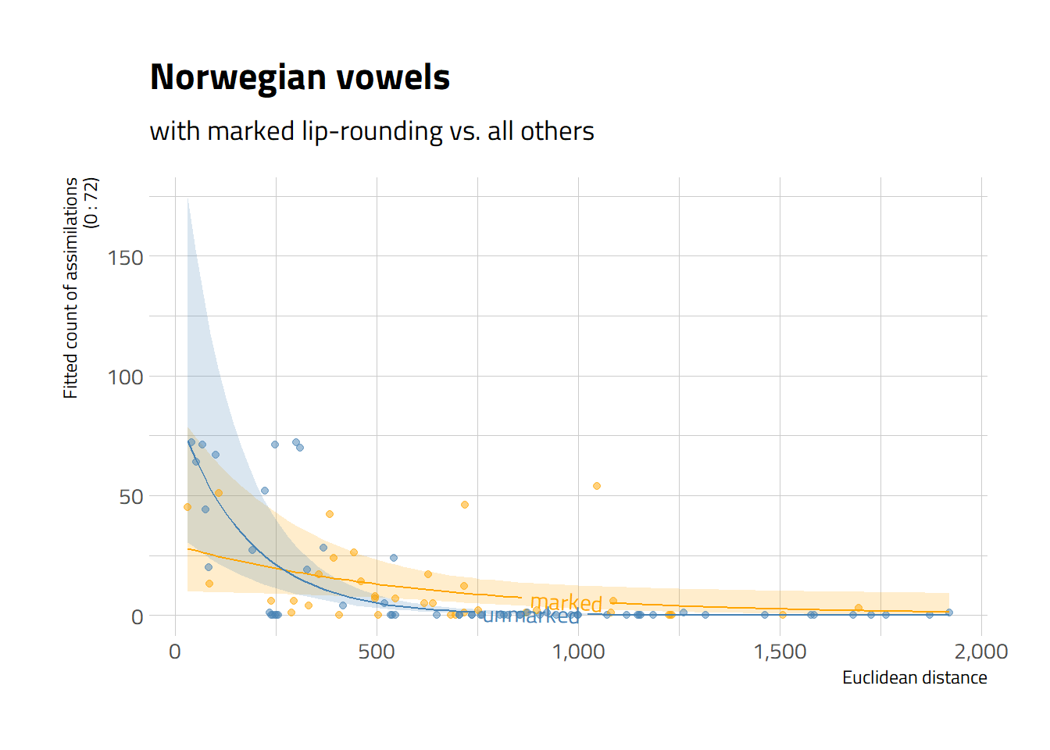
The influence of lip rounding on assimilation rates as determined by Euclidean distance — no indication
H2 predicted that Euclidean distance may have a weaker effect on assimilation rates in the case of vowels which have „more marked lip rounding”, i.e. high front or central rounded vowels.
The interaction ed:marked_rounding is positive and significant, but the effect of marked_rounding is not significant -> hard to interpret.
Unmarked vowels have higher predicted assimilation rates when the Euclidean distance = 0; the decrease in the predicted assimilation count for unmarked vowels is steeper.

Slide 18
The influence of Euclidean distance on perception in L2 and L3
H3/RQ: Does the Euclidean distance predict assimilation better in L2 or L3?
Coefficient in the Norwegian model of the standardized Euclidean distance predictor; ed_z = -1.706004
Coefficient in the English model of the standardized Euclidean distance predictor; ed_z= - 0.6104734.
The absolute value of the coefficient is larger in Norwegian, which suggests that there is a stronger effect of the Euclidean distance in L3 than in L2.
Interpretation: assimilations in the better-known L2 have stabilized taking into account other factors/features?

Slide 19
Are L2 or L3 vowels perceived as better exemplars of L1 categories? Reasoning behind the hypothesis.
H4: If we take into account the Euclidean distance, L2 vowels should be perceived as worse exemplars of L1 categories than L3 vowels.
Justification of the hypothesis:
It is one of the prerequisites for new category formation (Flege 1995, Flege and Bohn 2021) that listeners perceive differences between native and non-native sounds.
Since our participants are more advanced in L2, we expected that the process of new category formation for English vowels would be more advanced, and signaled by lower goodness of fit ratings.

Slide 21
L2 or L3 vowels as better exemplars of L1?
Results: mixed effects linear model of Likert rating as a function of centered and standardized Euclidean distance, language and their interaction. The model includes by-participant random intercept.
Larger Euclidean distance means lower goodness of fit ratings in both languages.
At mean value of the Euclidean distance (in the plot =0), the English vowels are rated higher than Norwegian vowels. The effect of language is significant.
Disclosure: it was a general comparison of the two systems. Typologically and phonologically, there are many features that make Norwegian vowels more marked than English vowels. Perhaps due to them English vowels turn out to be more similar to Polish vowels than Norwegian vowels.

Slide 22
Summary of the results
The smaller the Euclidean distance between two vowels, the higher the likelihood of assimilating a given non-native vowel to a native category.
There is some indication that marked lip rounding may influence assimilation patterns, but no indication that length plays a role.
There is a stronger effect of the Euclidean distance in the L3 than in L2.
L2 English vowels seem more similar to L1 Polish vowels than L3 Norwegian vowels.

Slide 23
Limitations
To examine the influence of L2/L3 on the perceived similarity of vowels/goodness of fit ratings we would also need a pair in which L2 has more marked vowels than L3. L2 English and L3 Spanish perhaps.

Slide 24
Further research
This study has been a part of a larger project:
Vowel production
Comparison of vowel perception and production
Syntactic experiments
Comparison of the acquisition in natural vs. instructed settings.

Slide 25
References
Alispahic, S., Mulak K.E.., & Escudero P. 2017. Acoustic properties predict perception of unfamiliar Dutch vowels by adult Australian English and Peruvian Spanish listeners. Frontiers in Psychology 8 (52).
Best C. & Tyler, M. (2007). Non-native and second language speech perception: Commonalities and complementarities. In M. Munro & O-S. Bohn (Eds.), Language experience in second language speech learning: In honor of James Emil Flege (pp. 13-34). Amsterdam: John Benjamins.
Escudero, P., Simon, E., & Mitterer, H. (2012). The perception of English front vowels by North Holland and Flemish listeners: acoustic similarity predicts and explains cross-linguistic and L2 perception. Journal of Phonetcis 40 (2), 280-288.
Flege, J. E. (1995). Second language speech learning: Theory, findings, and problems. In: Strange (Ed.) Speech perception and linguistic experience: Issues in cross-language research (pp. 233-277). Timonium, MD: York Press.
Flege, J. E., & Bohn, O.-S. (2021). The revised speech learning model (SLM-r). W R. Wayland (Ed.), Second Language Speech Learning (pp. 3–83). Cambridge University Press. https://doi.org/10.1017/9781108886901.002
Peirce, J. W., Gray, J. R., Simpson, S., MacAskill, M. R., Höchenberger, R., Sogo, H., Kastman, E., Lindeløv, J.2019. PsychoPy2: experiments in behavior made easy. Behavior Research Methods.10.3758/s13428-018-01193-y
Strange, W., Bohn, O-S., Trent, S. & Nishi K. (2004). Acoustic and perceptual similarity of North German and American English vowels. Journal of the Acoustical Society of America, 115(4), 1791-1807.
Tyler, M.D., Best C.T., Faber, A. & Levitt, A.G. (2014). Perceptual Assimilation and Discrimination of Non-Native Vowel Contrasts. Phonetica 71, 4-21. v Wood, S.N. (2017) Generalized Additive Models: An Introduction with R (2nd edition). Chapman and Hall/CRC.

Slide 26
This study has been a result of a research project Opus-19-HS (UMO-2020-37/B/HS2/00617) CLIMAD „Cross-linguistic influence in multilingualism across domains: Phonology and syntax” financed by the National Science Centre, Poland. PI: Magdalena Wrembel.
Thank you for your attention.
We are grateful to Karolina Rataj and Witosław Awedyk for their comments at the stage of experiment design and Zuzanna Cal and Nicole Rodriquez for their help with data collection.

